Slide 1


Slide 2


Slide 3


Slide 4


Slide 5


Slide 6


World’s Largest Food Laboratory

Slide 7


Slide 8


Slide 9


Slide 10


Slide 11


Slide 12


Slide 13


Slide 14


Slide 15
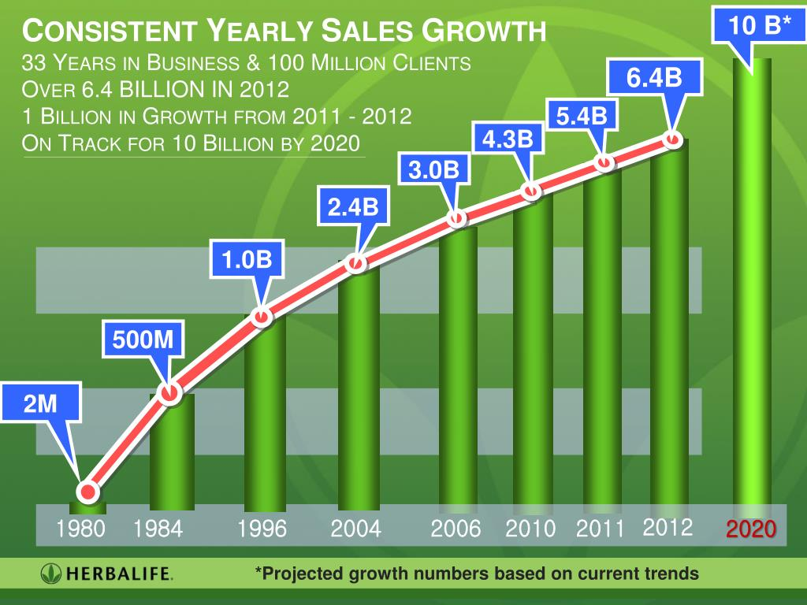

Slide 16



Slide 17
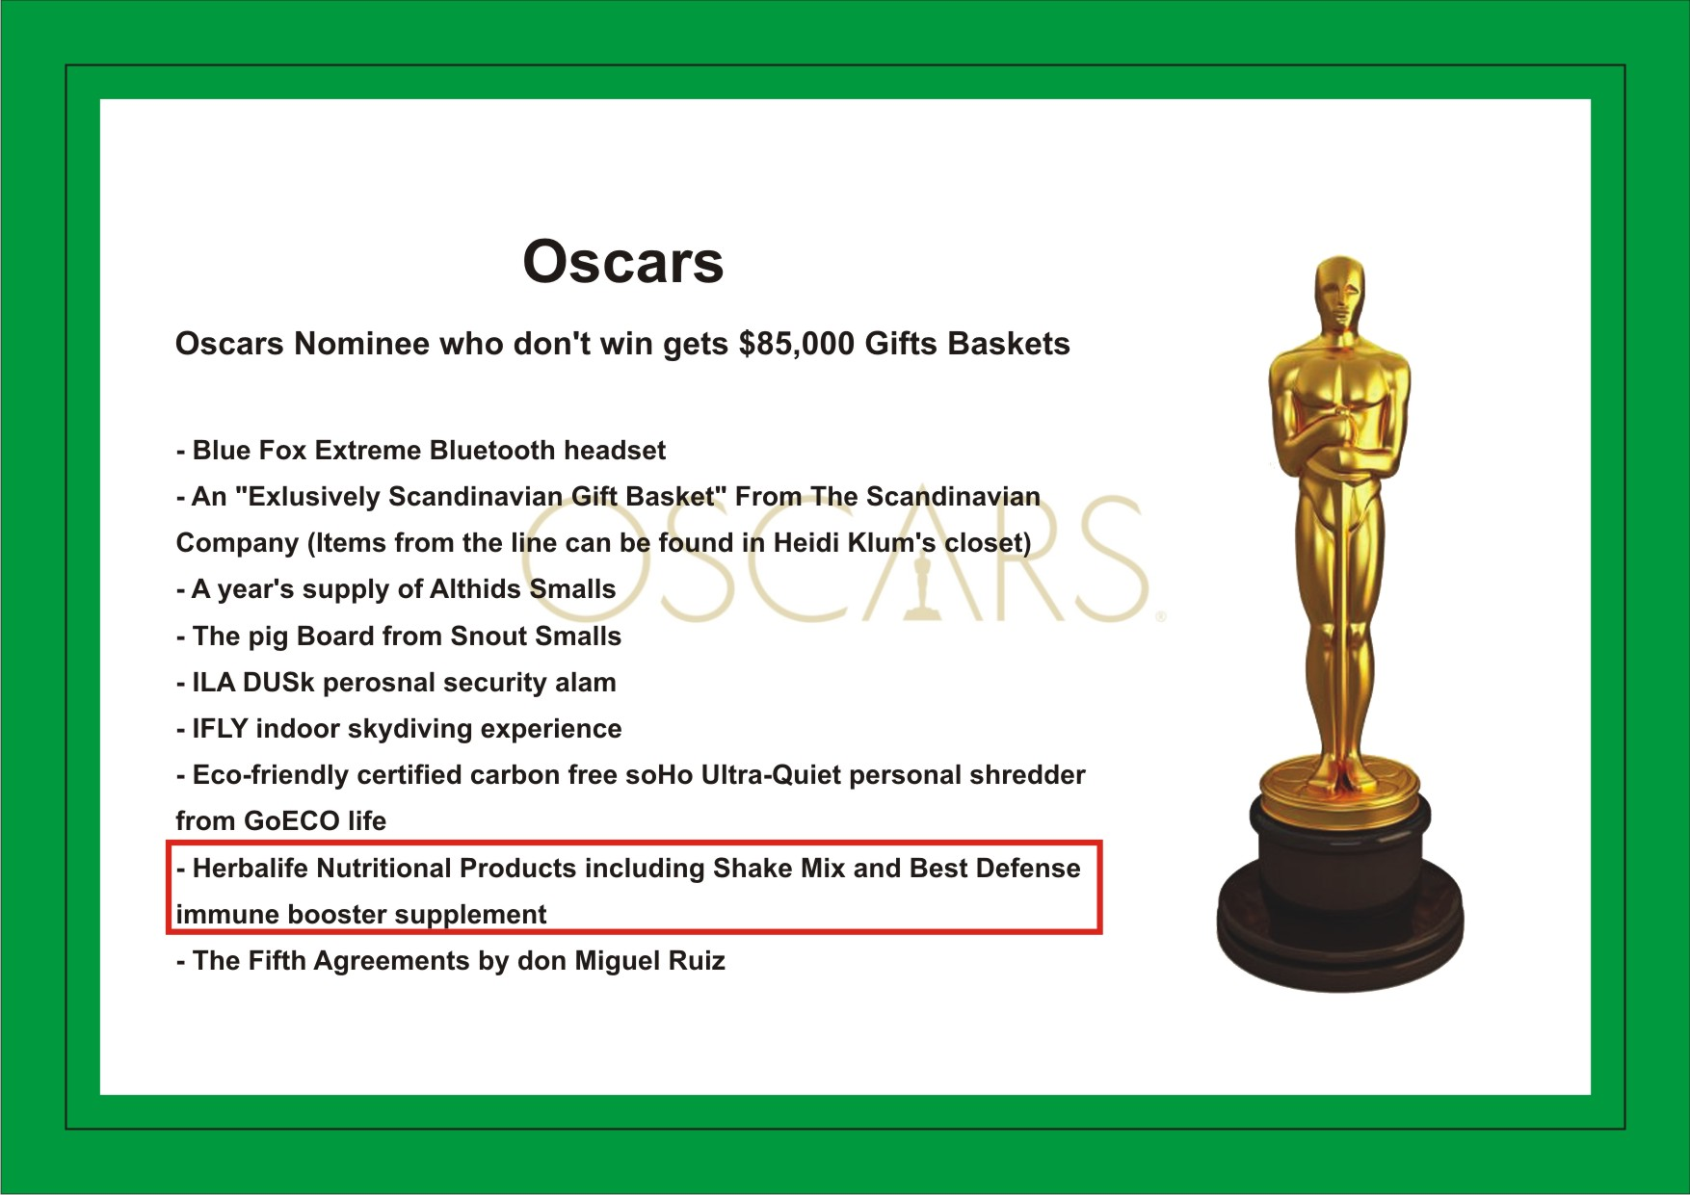
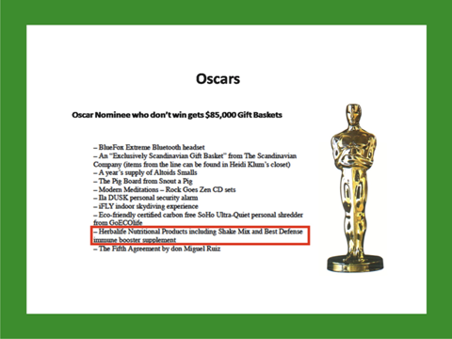

Slide 18


Slide 19



Slide 20



Slide 21


Slide 23
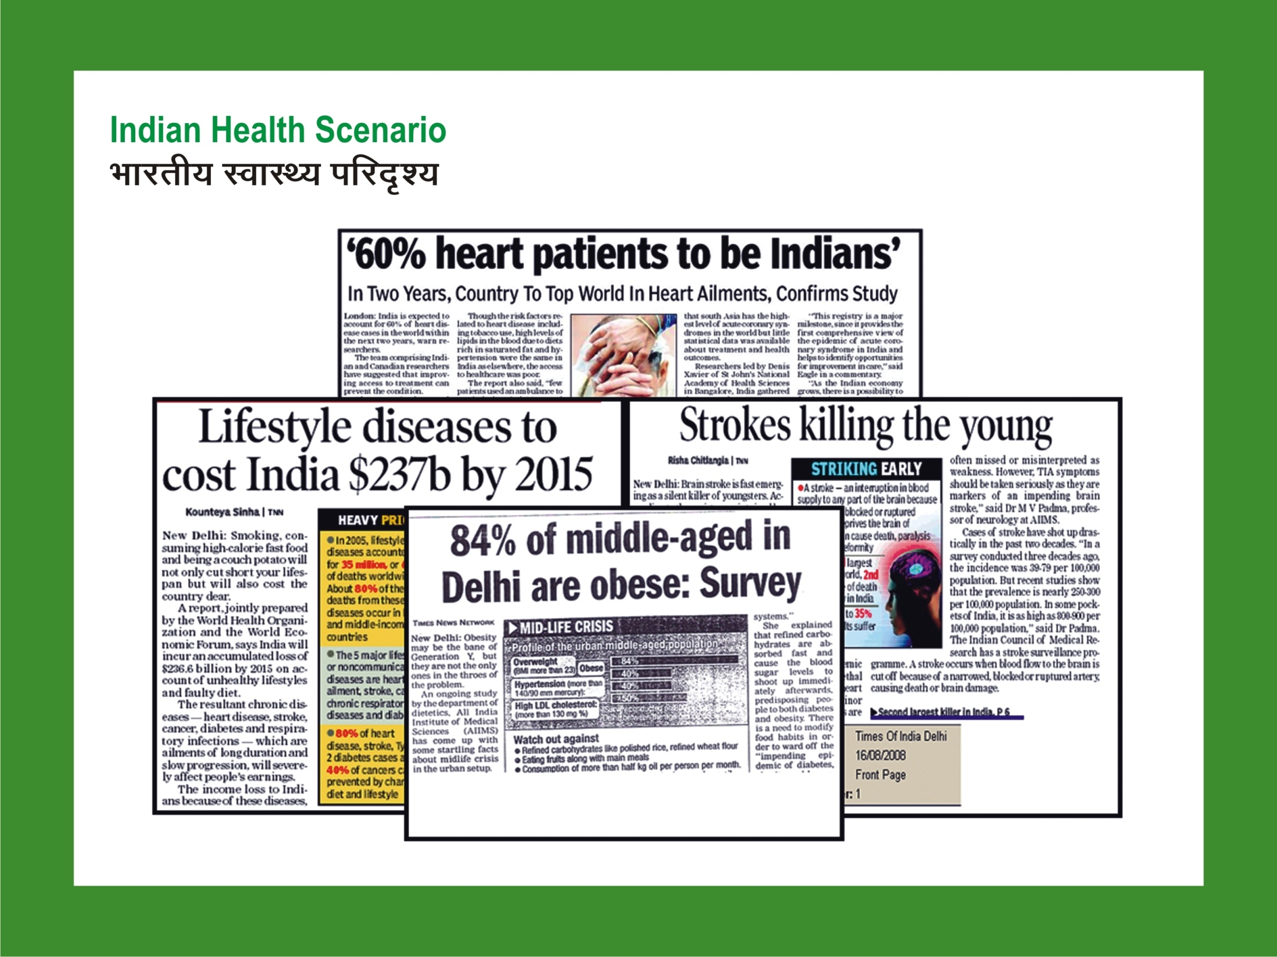

Slide 24
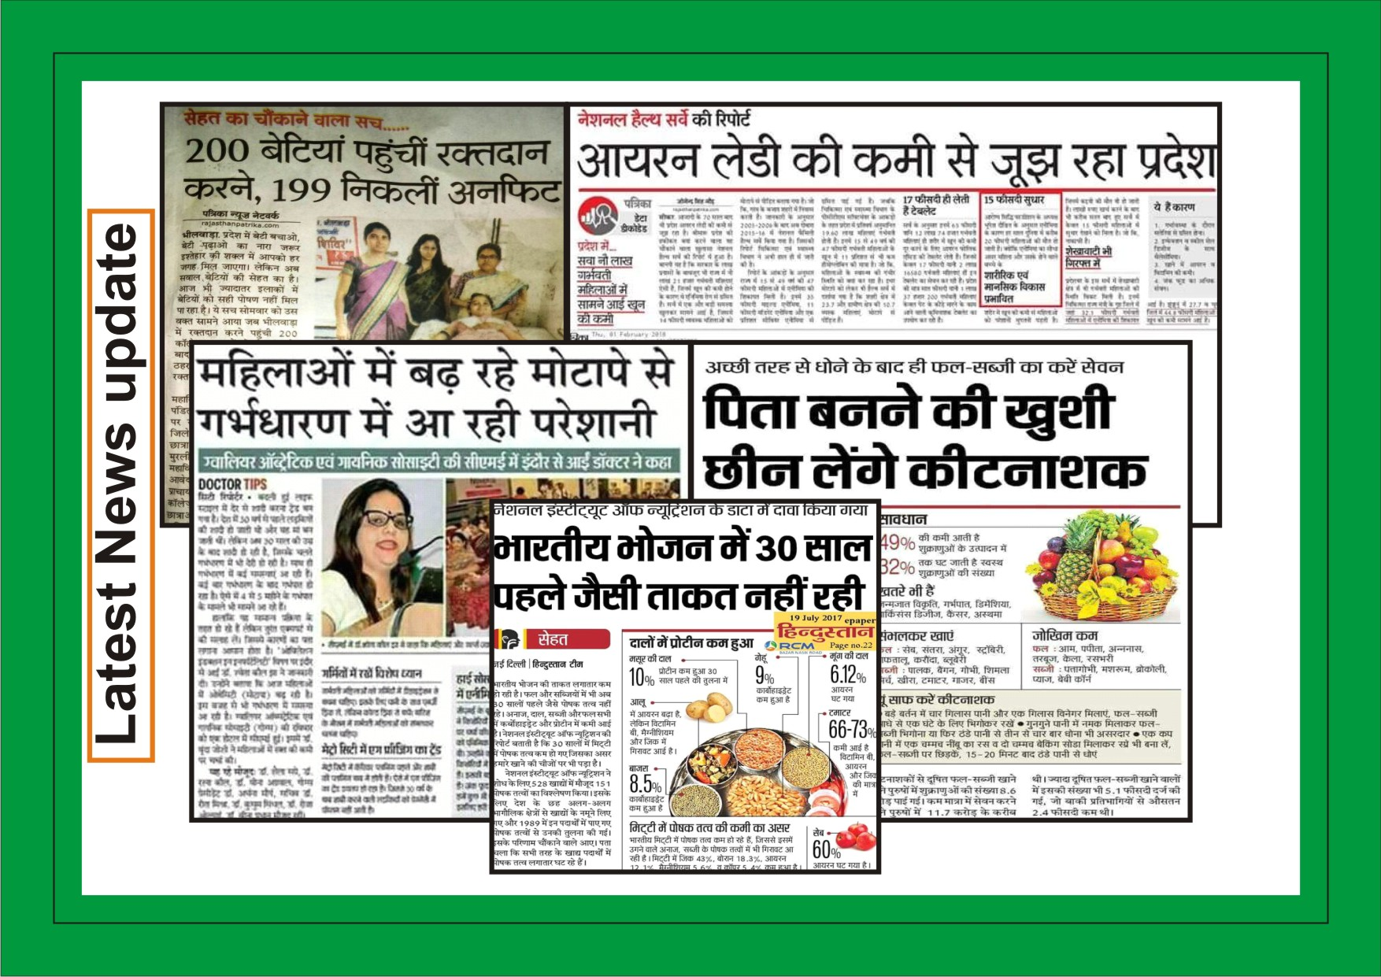

Slide 25
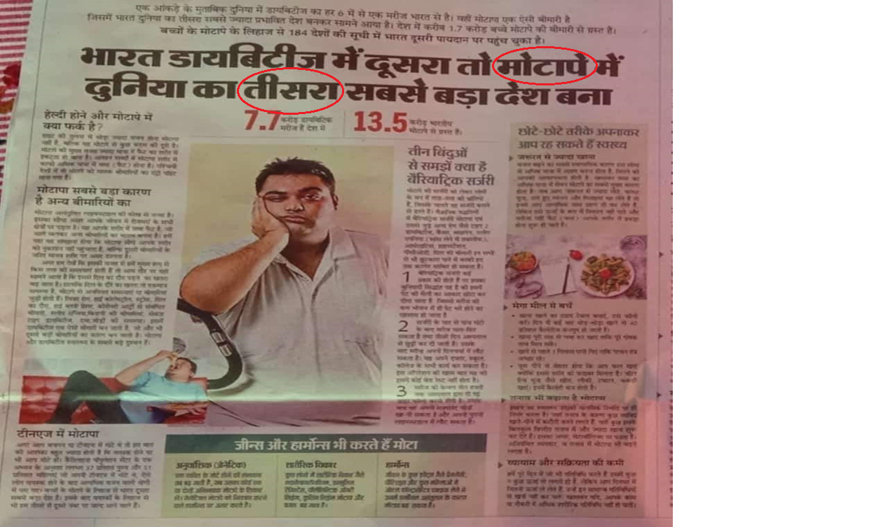

Slide 26


Slide 27
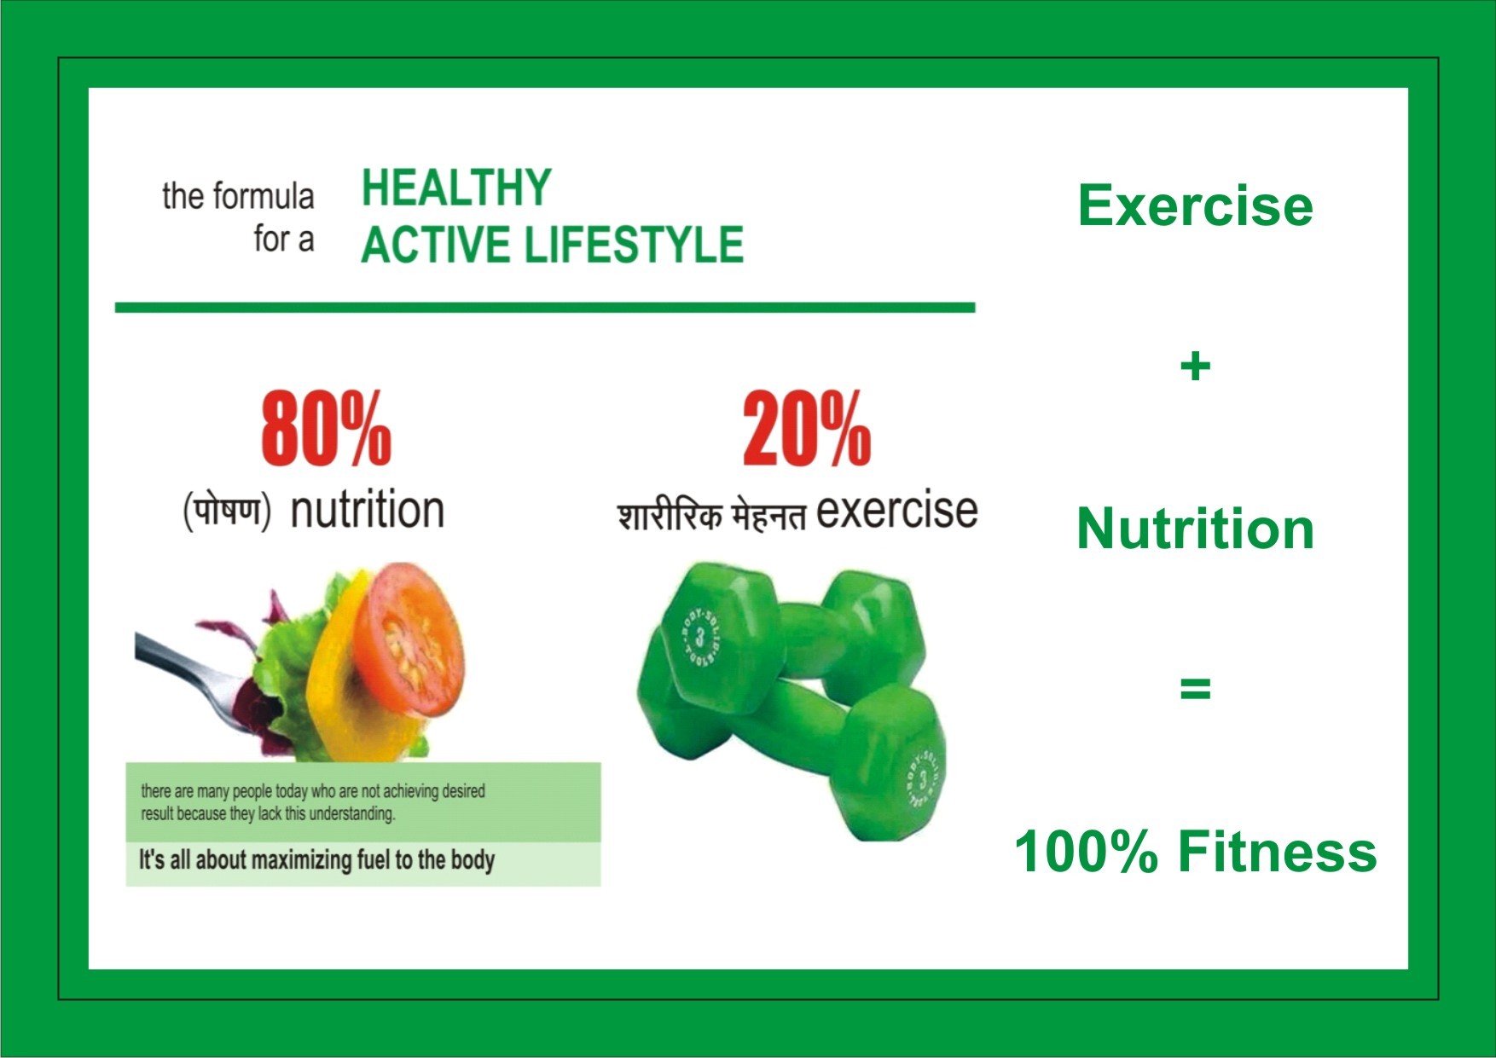

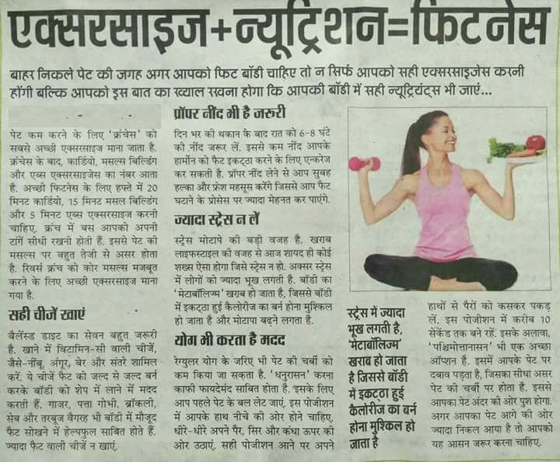

Slide 28
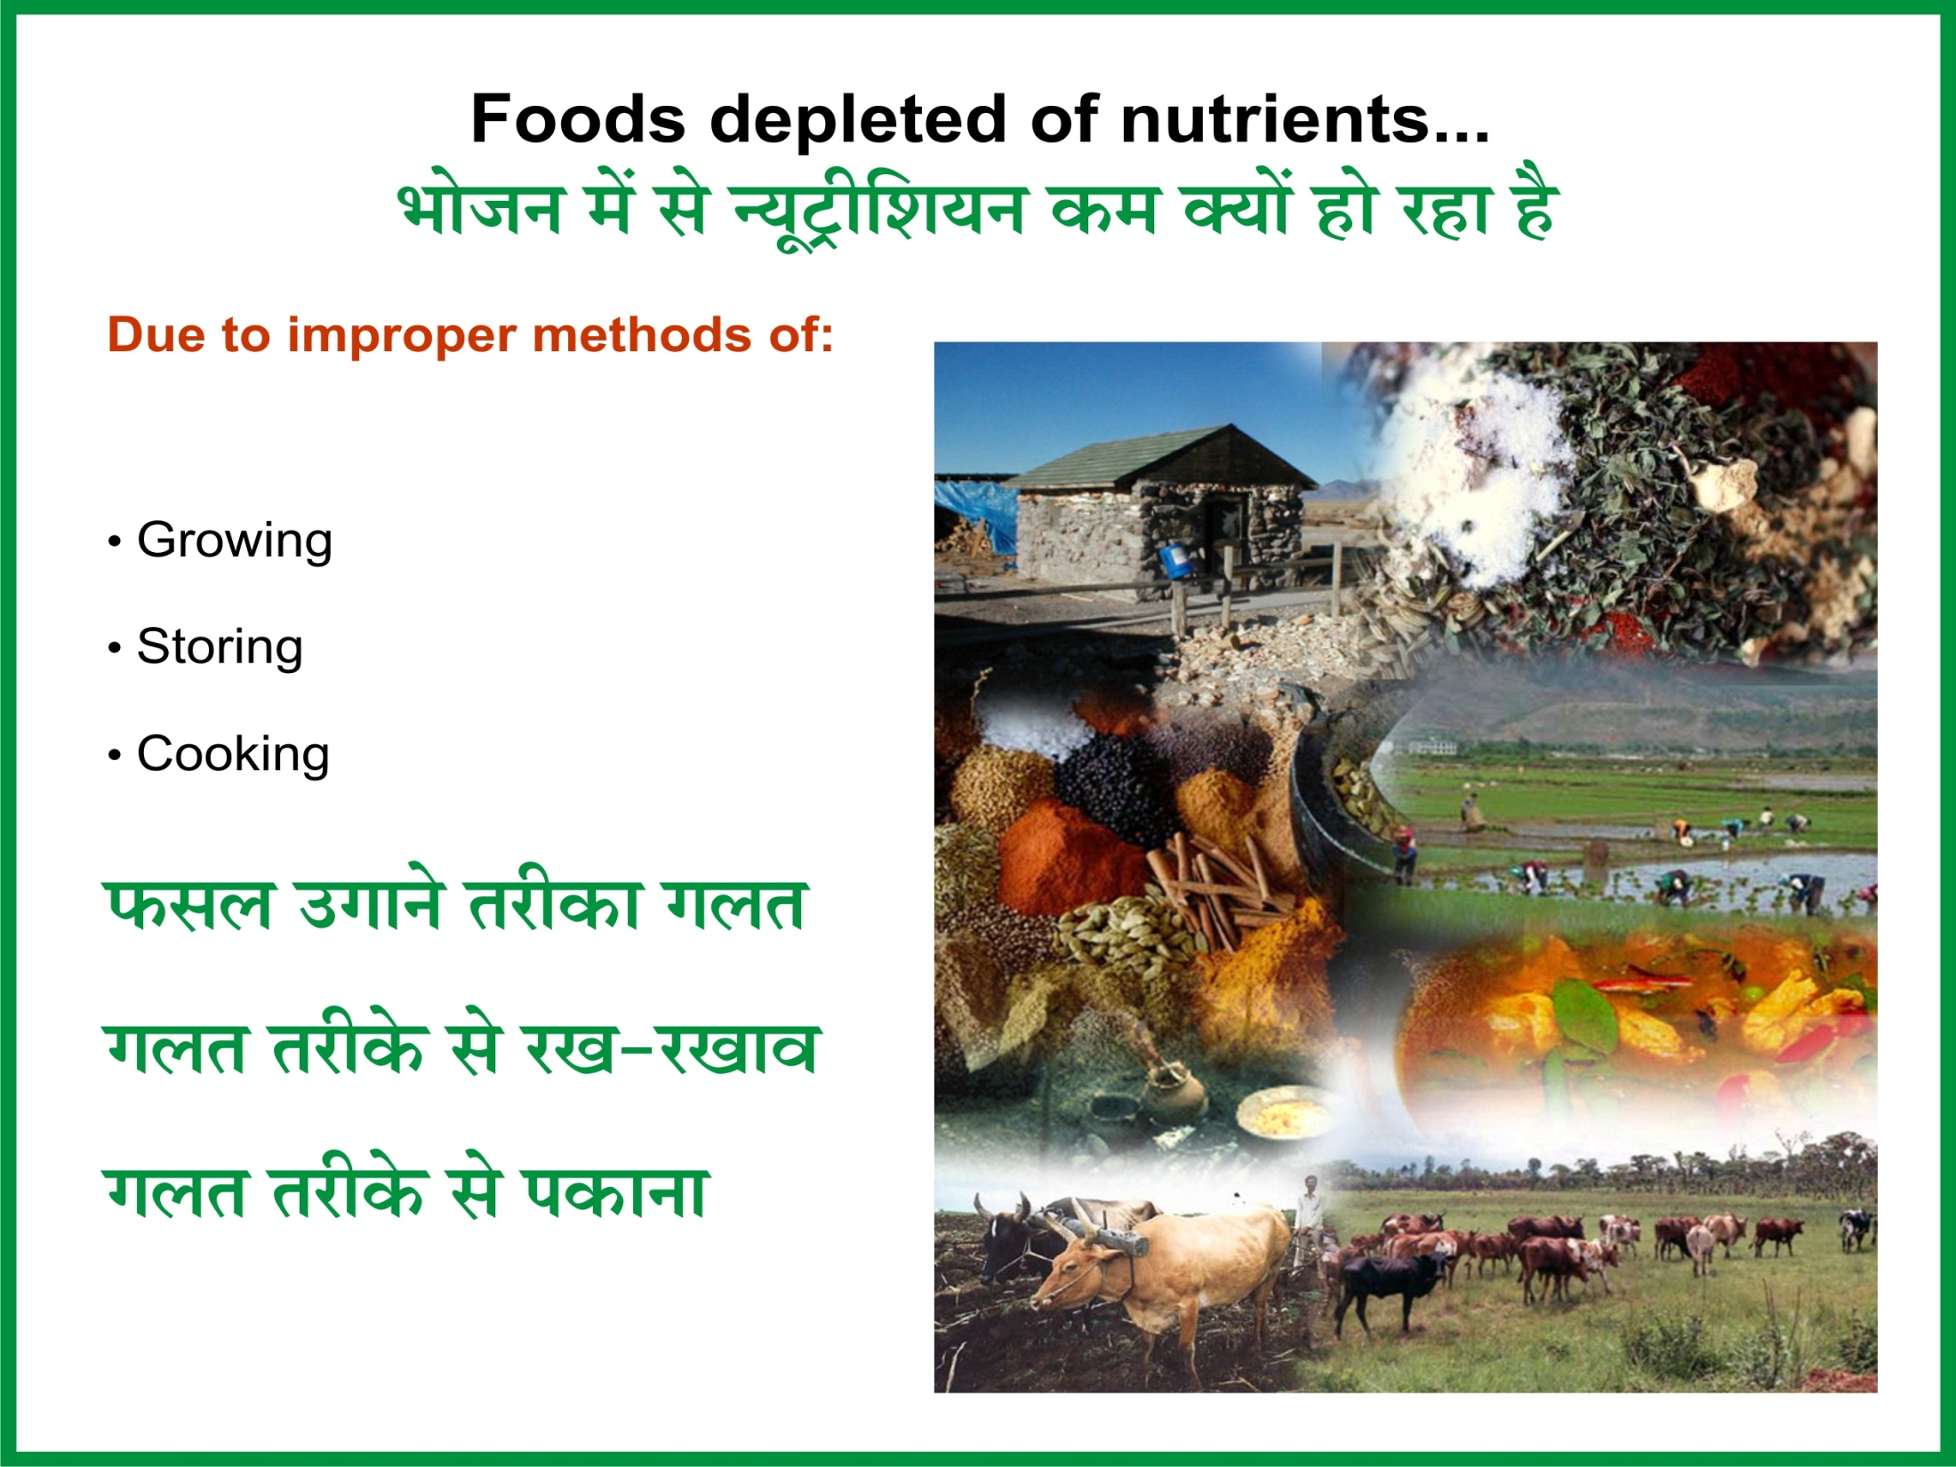

Slide 29
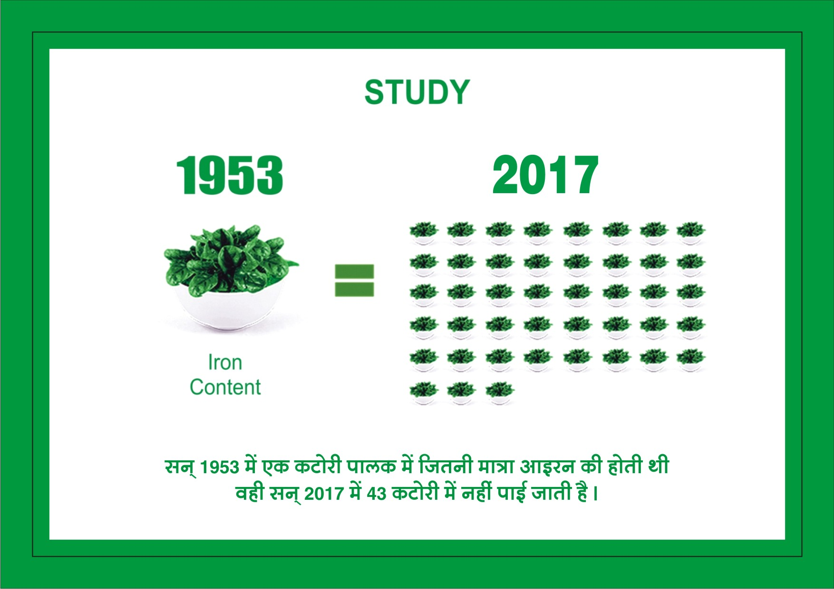
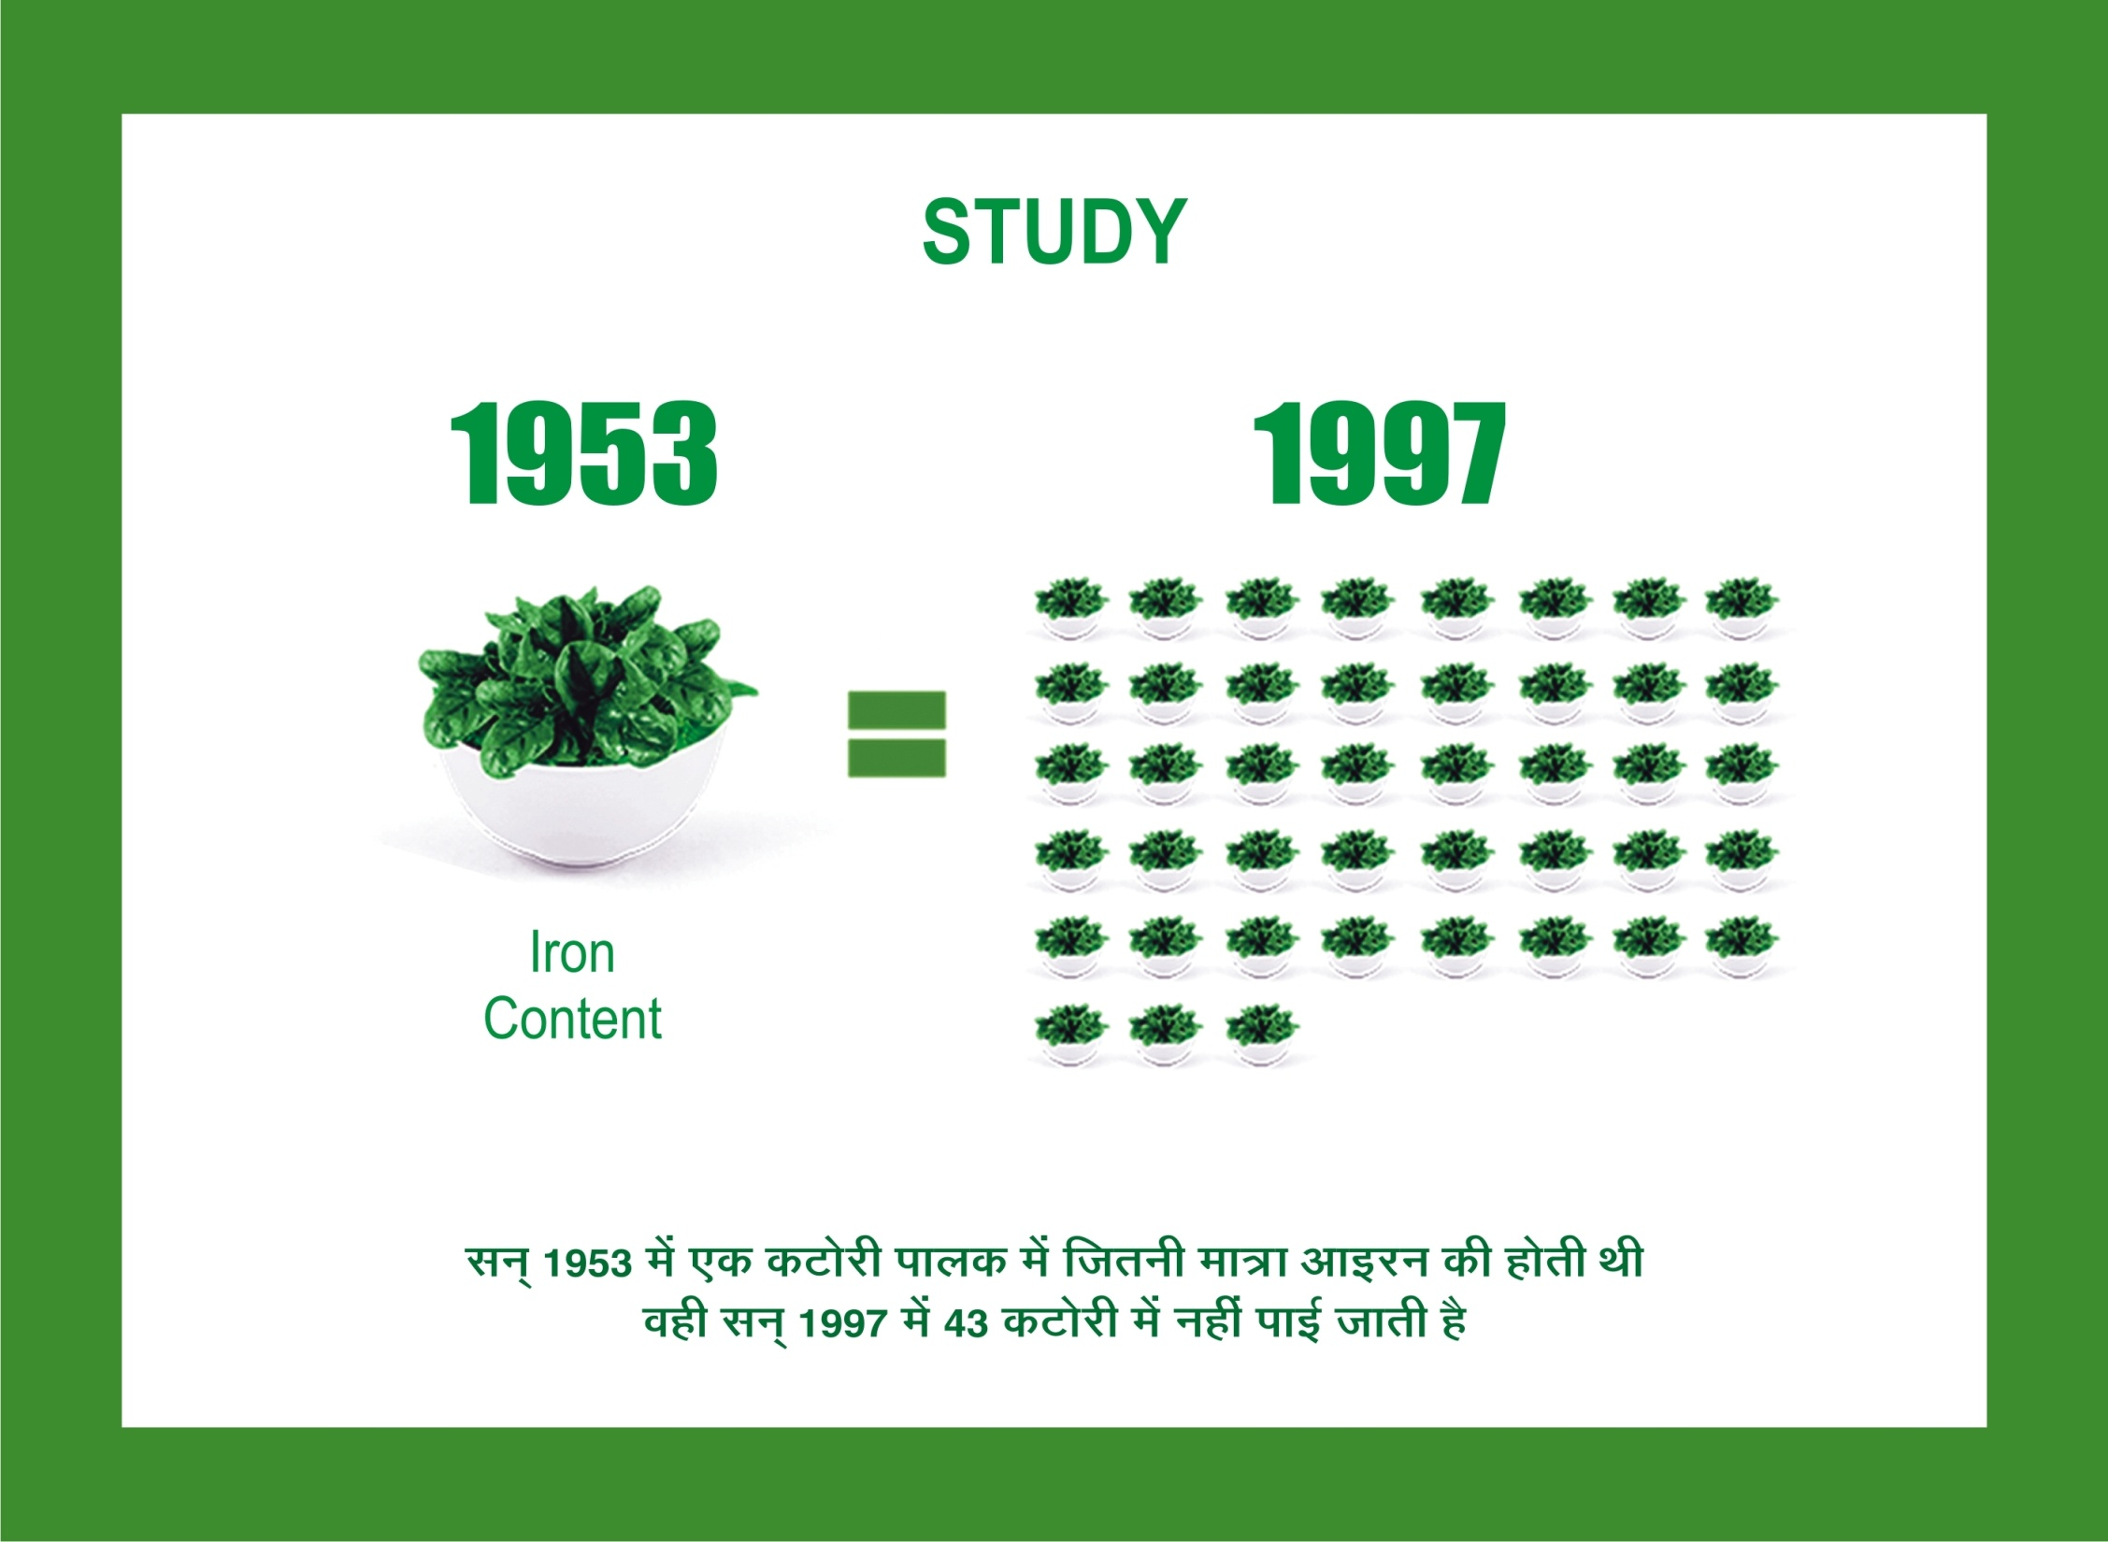

Slide 30
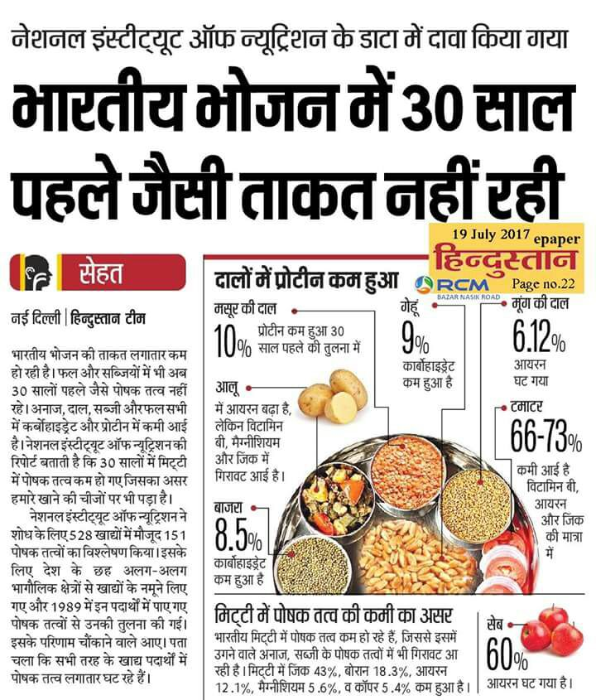

Slide 31
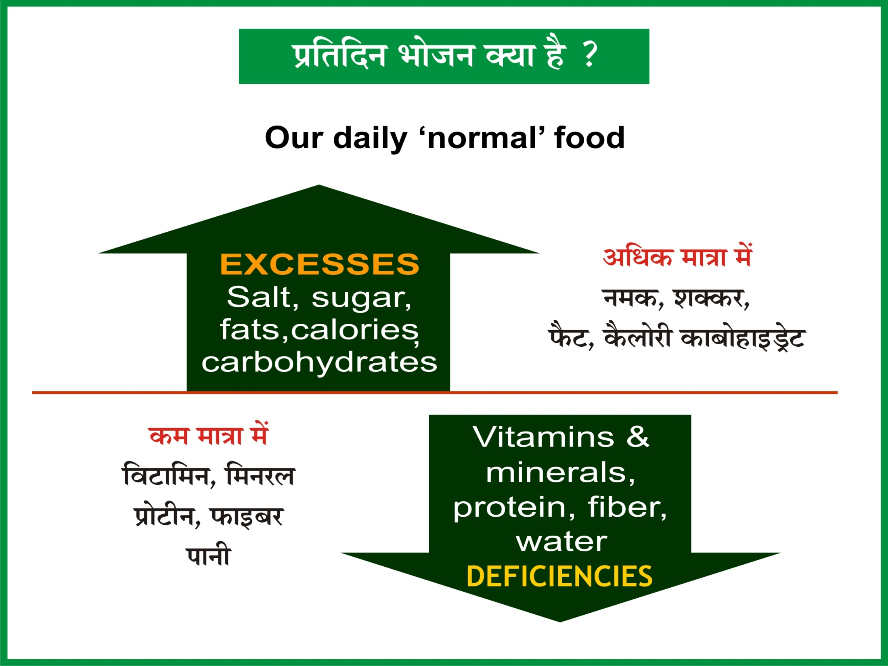

Slide 32
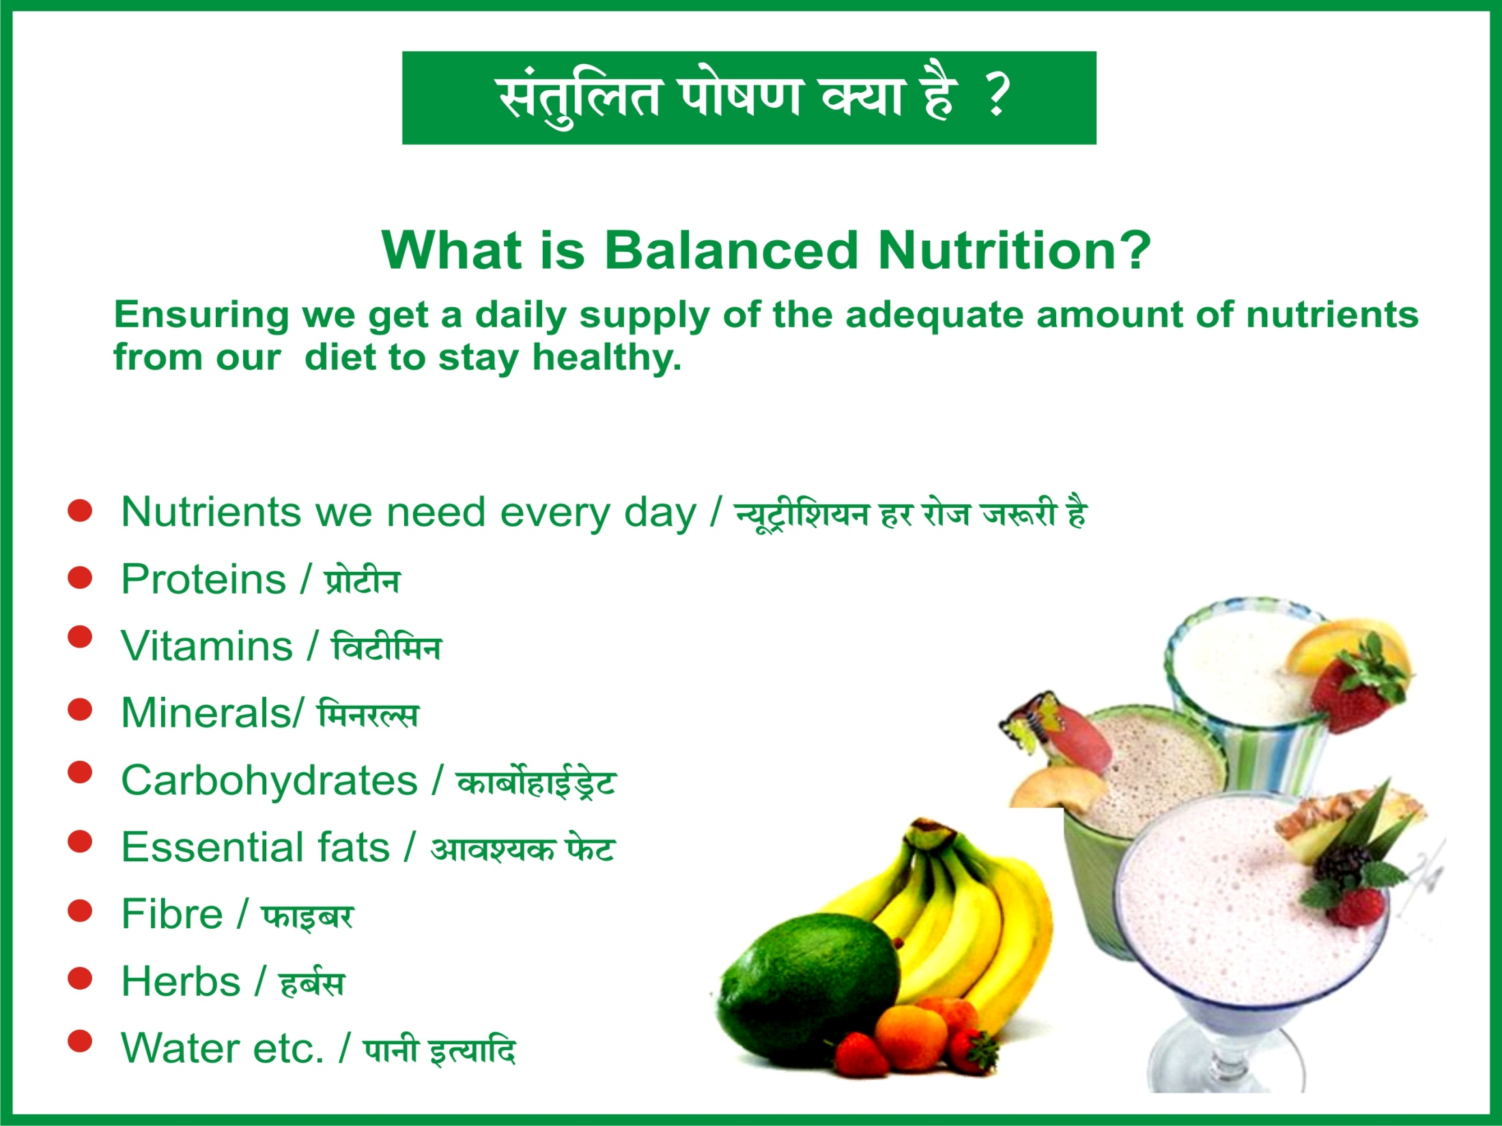

Slide 33


Slide 34


Slide 35


Slide 36
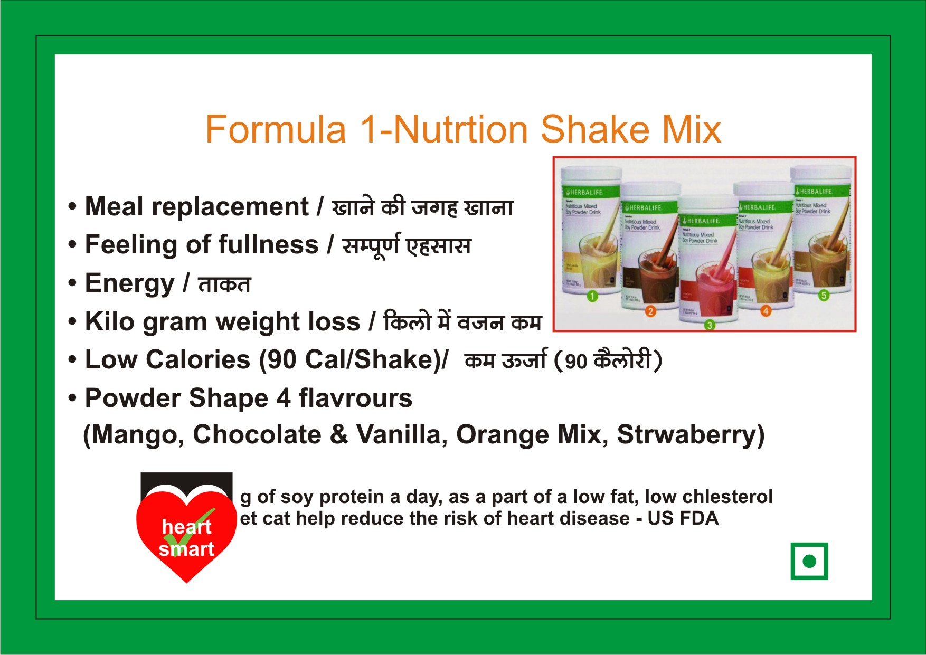


Slide 37
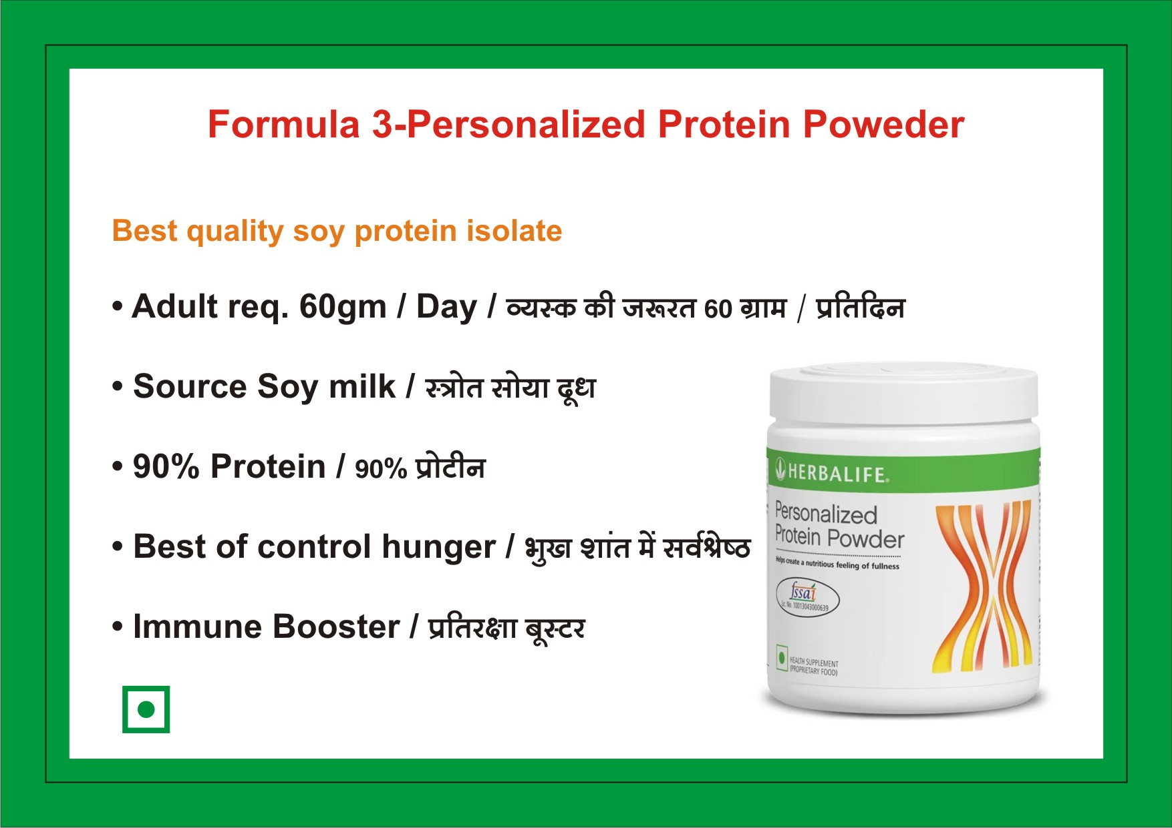
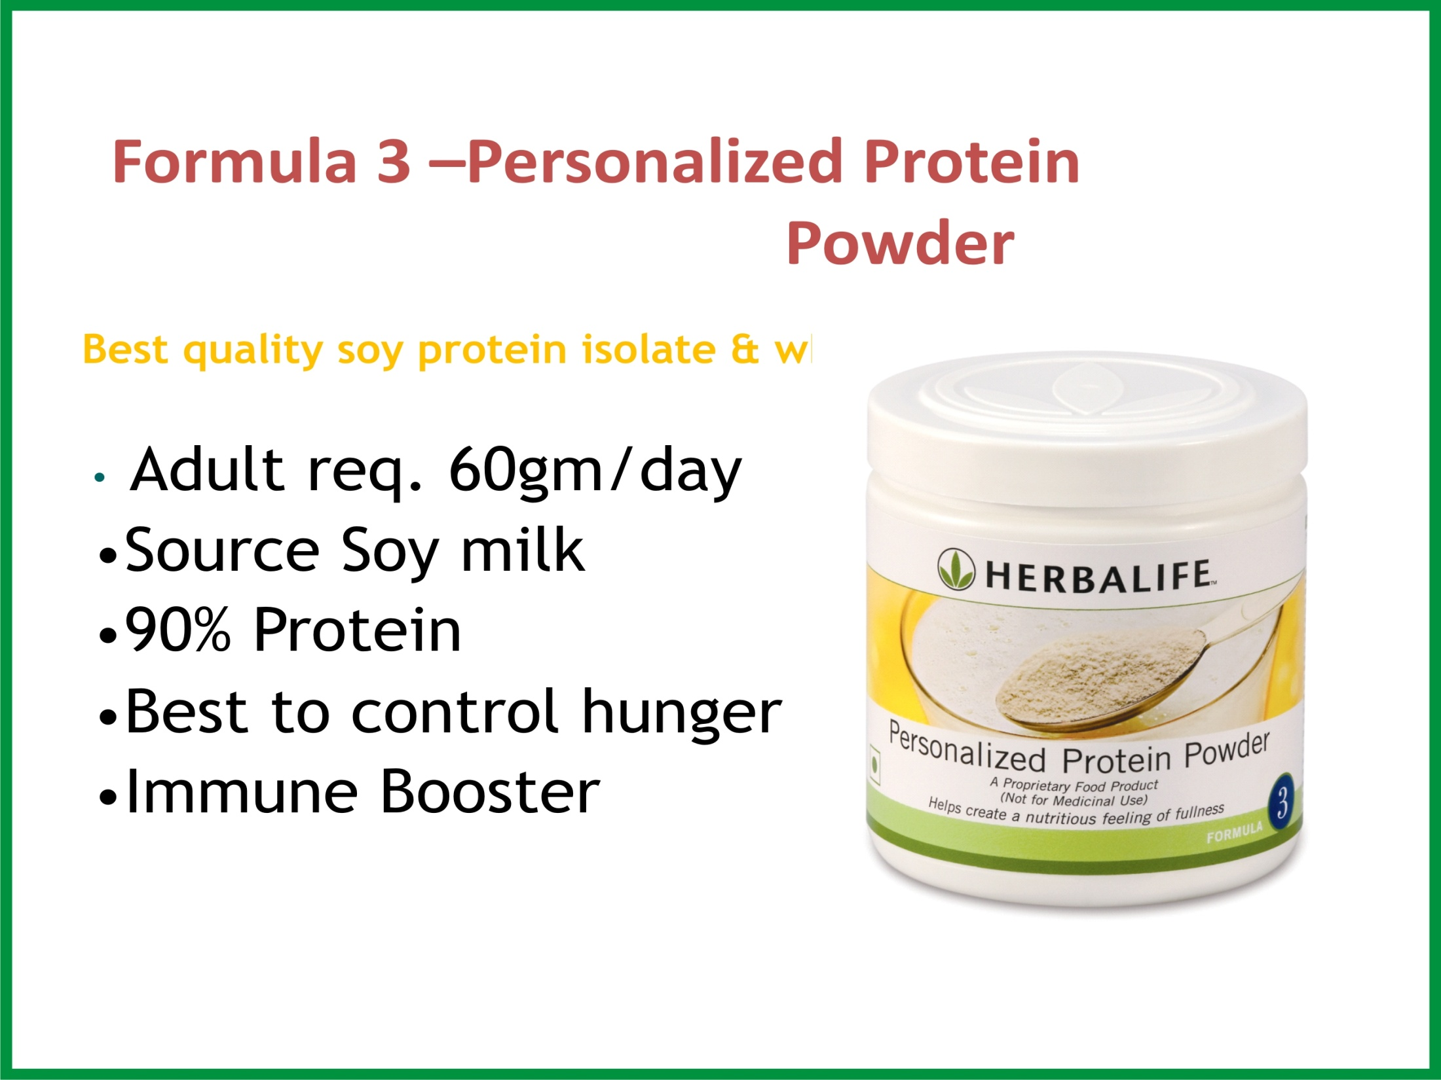

Slide 38
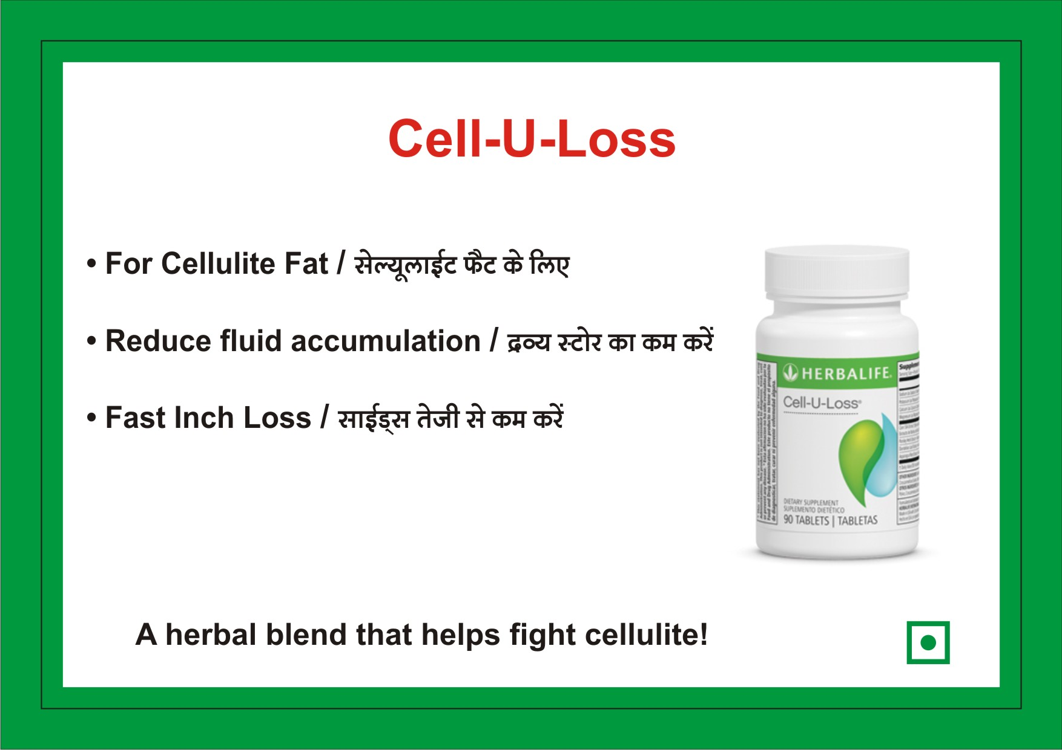
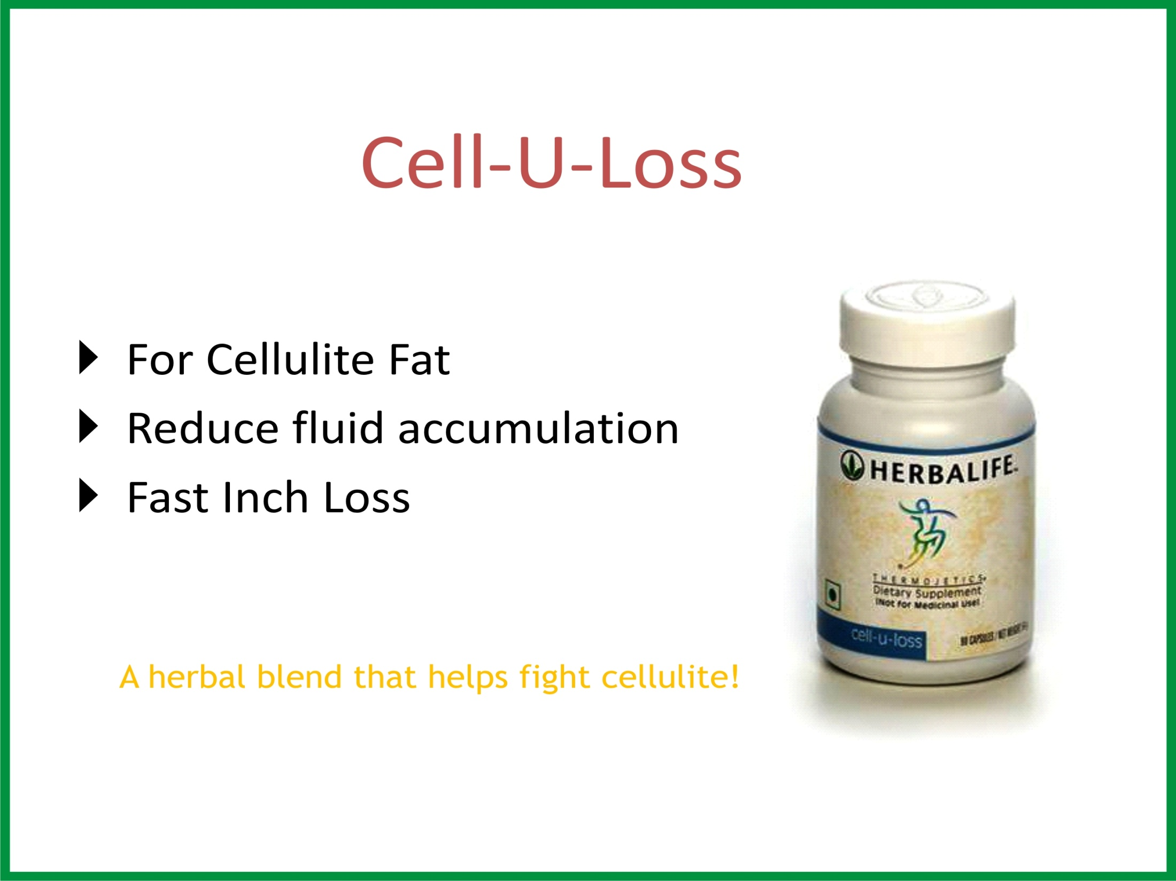

Slide 39
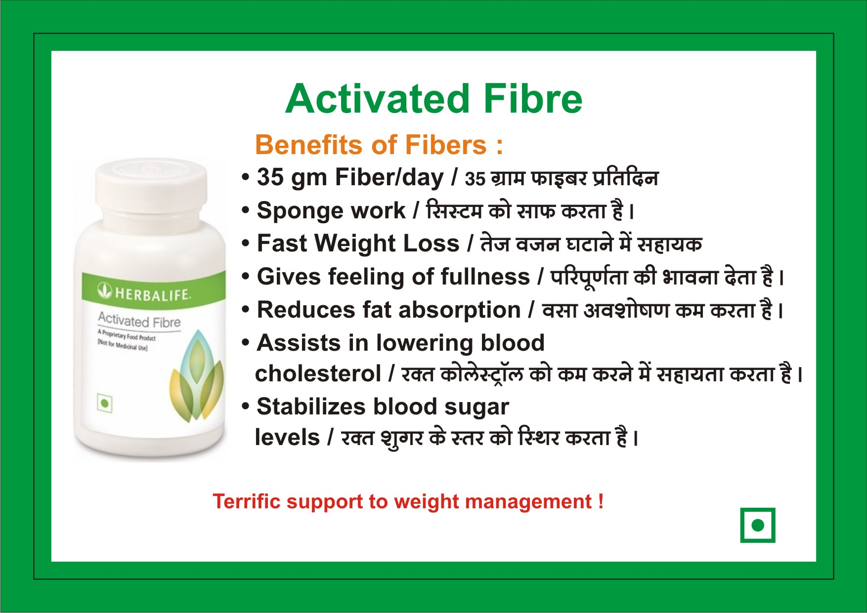
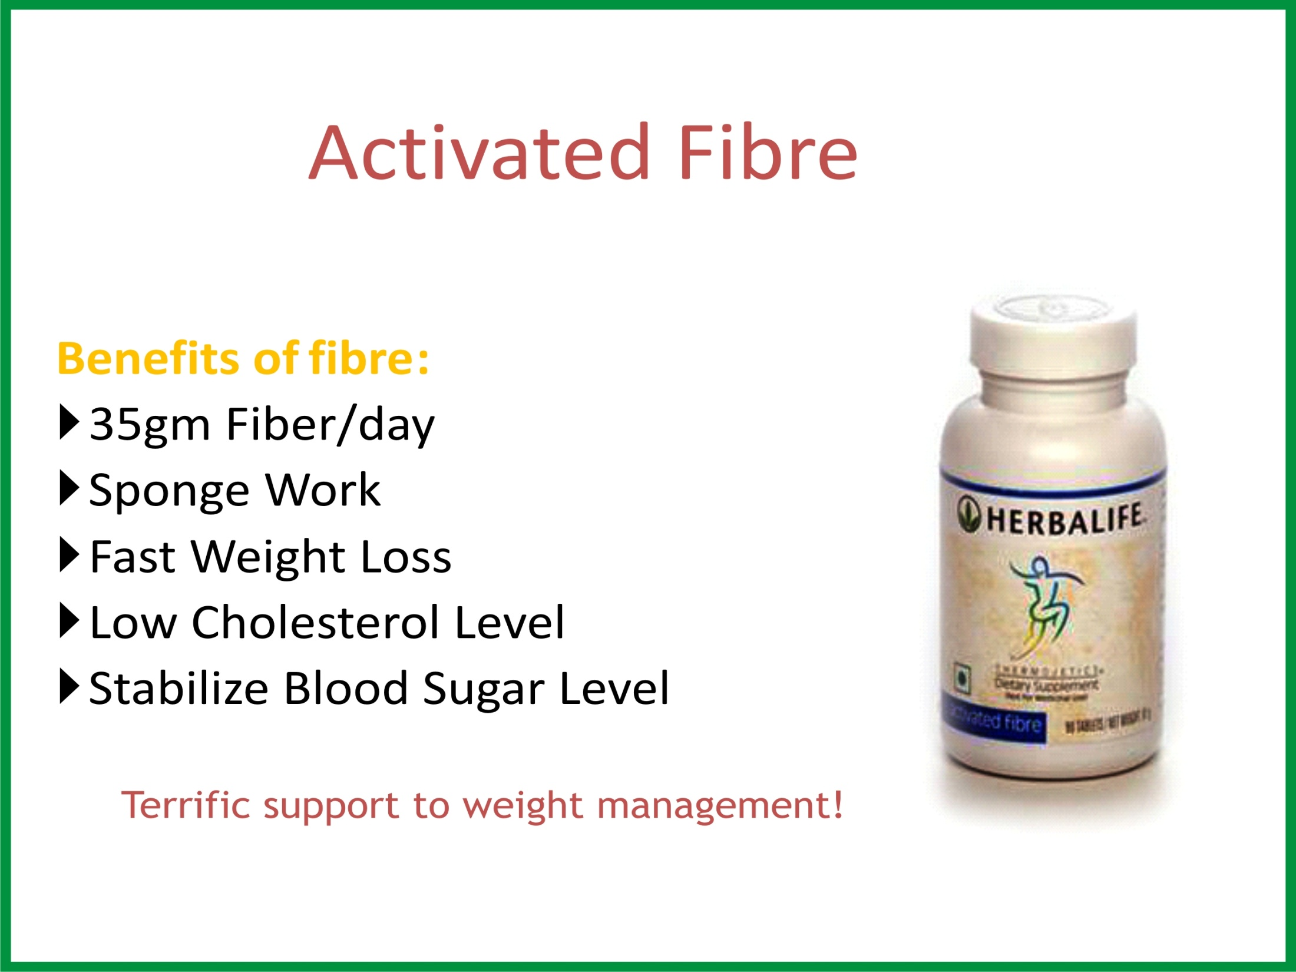

Slide 40



Slide 41



Slide 42
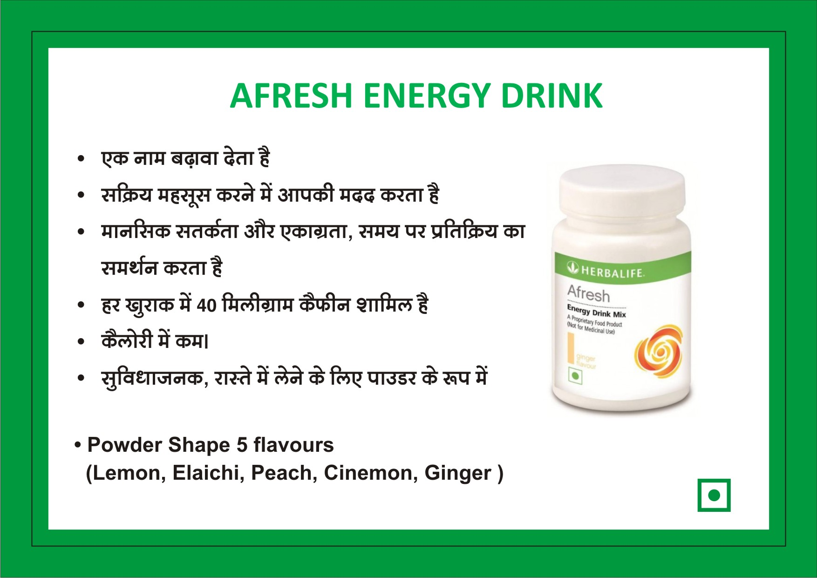
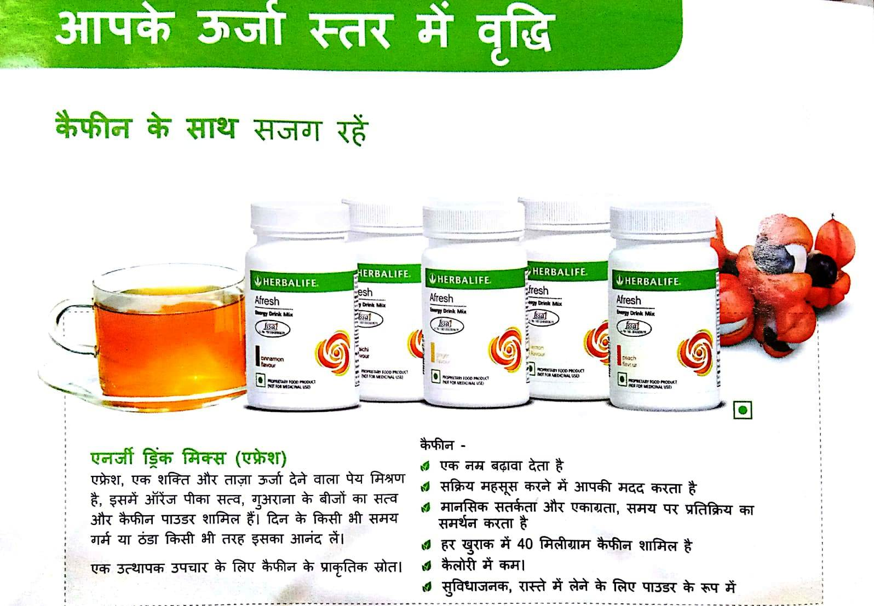
AFRESH ENERGY DRINK

Slide 43
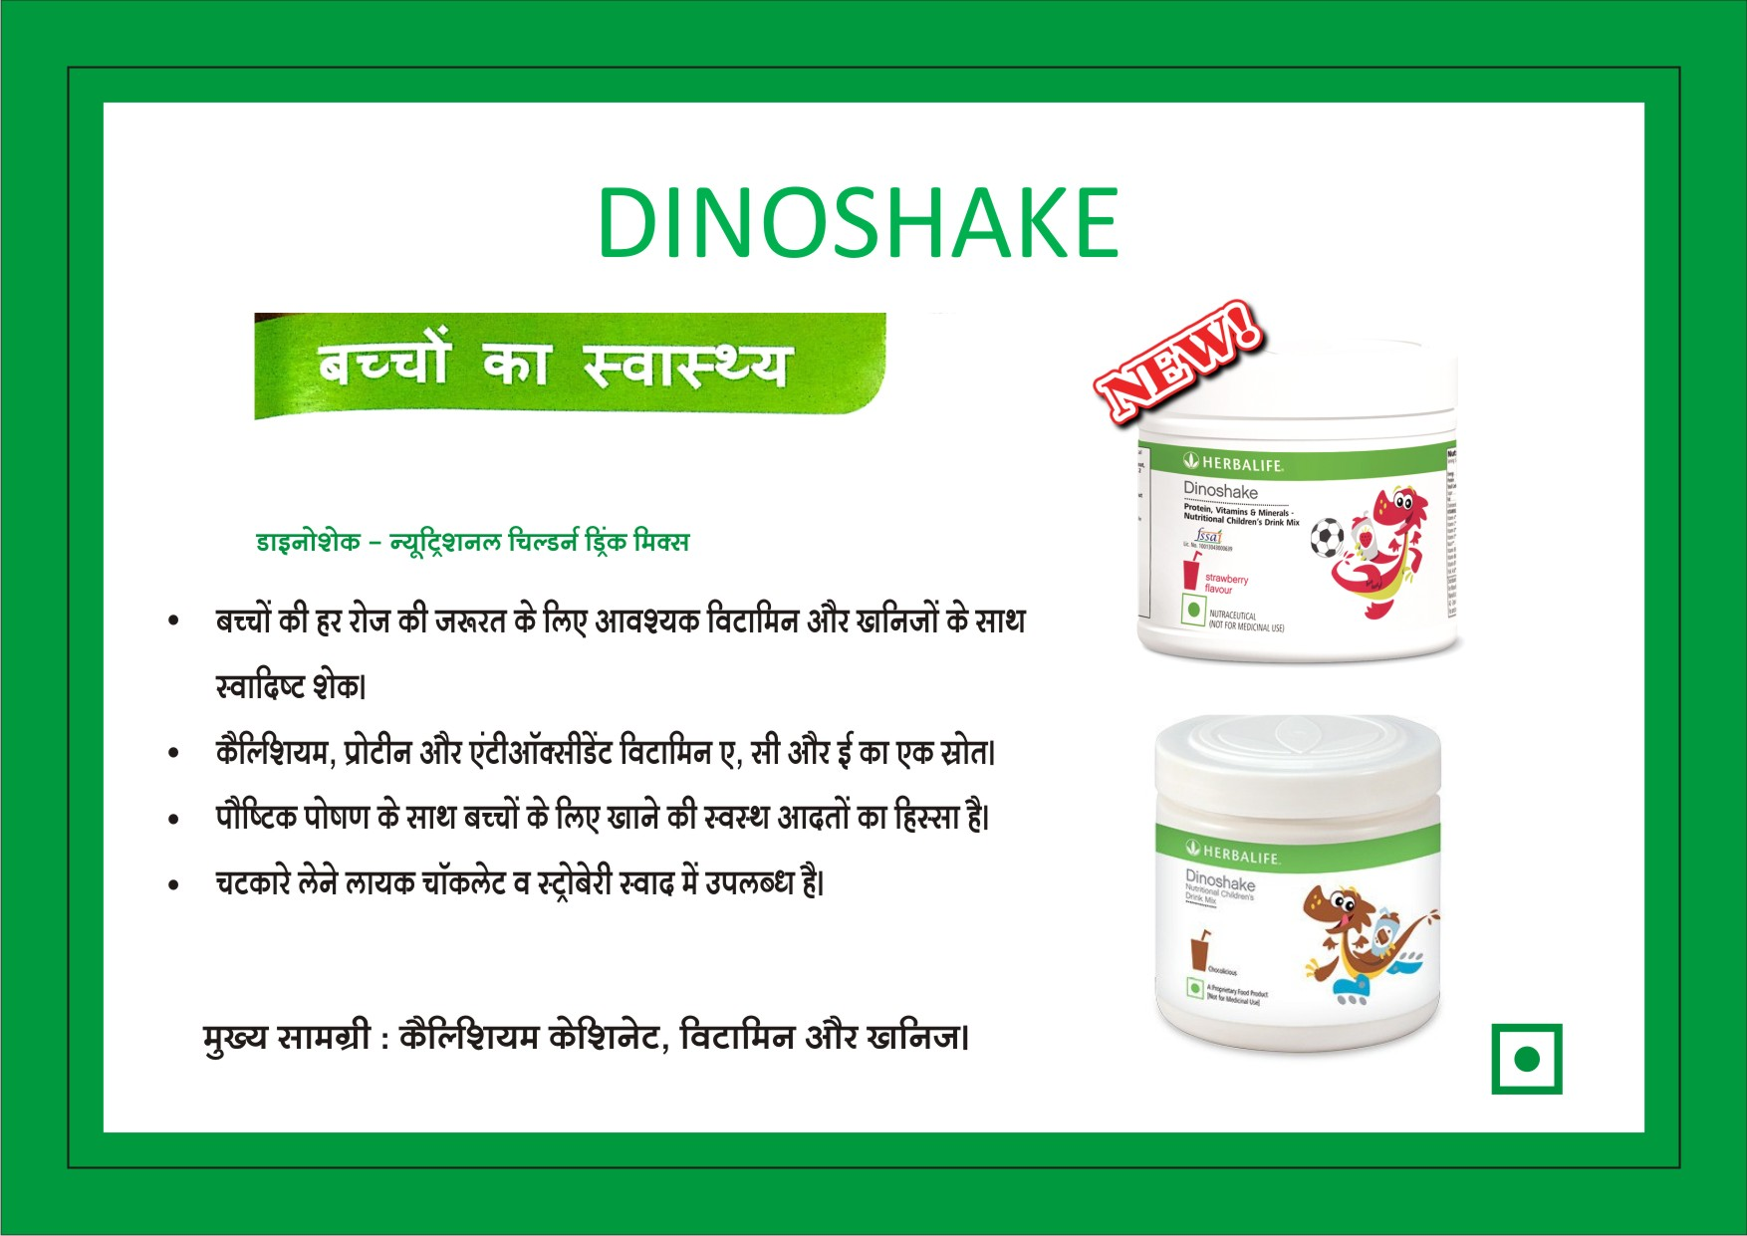
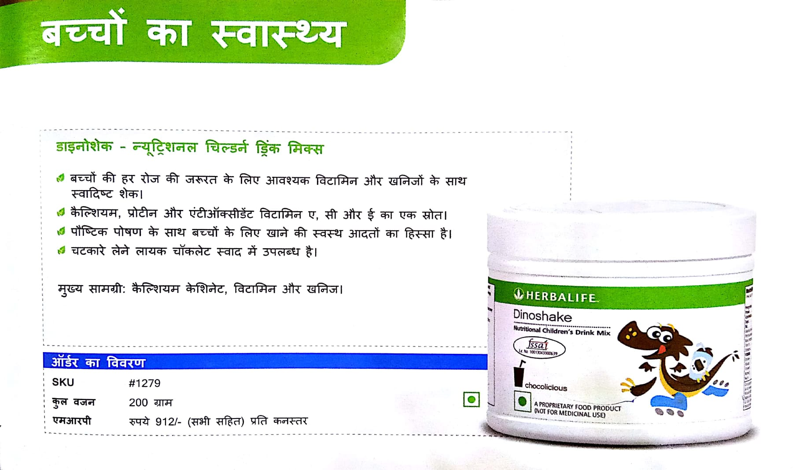
DINOSHAKE

Slide 44

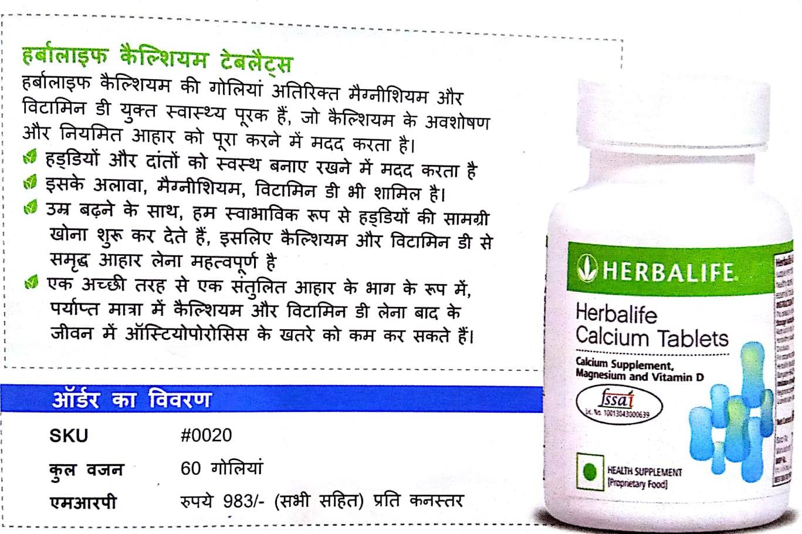
CALCIUM TABLETS

Slide 45

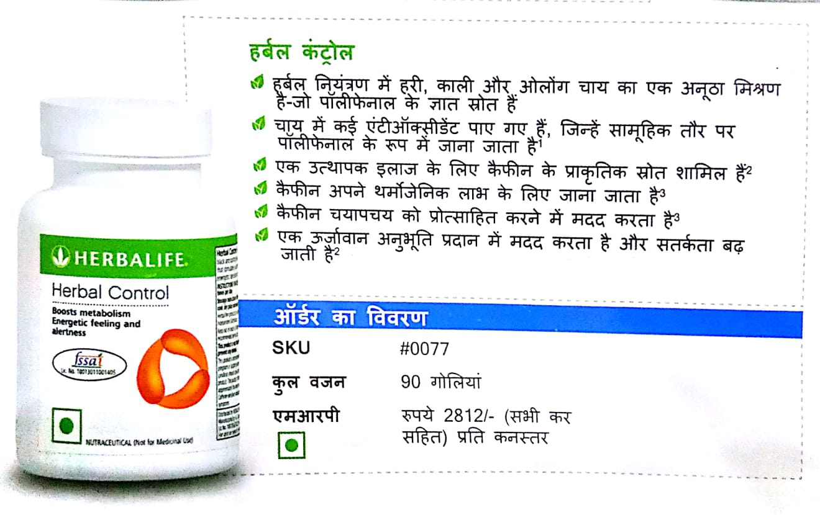
HERBAL CONTROL

Slide 46

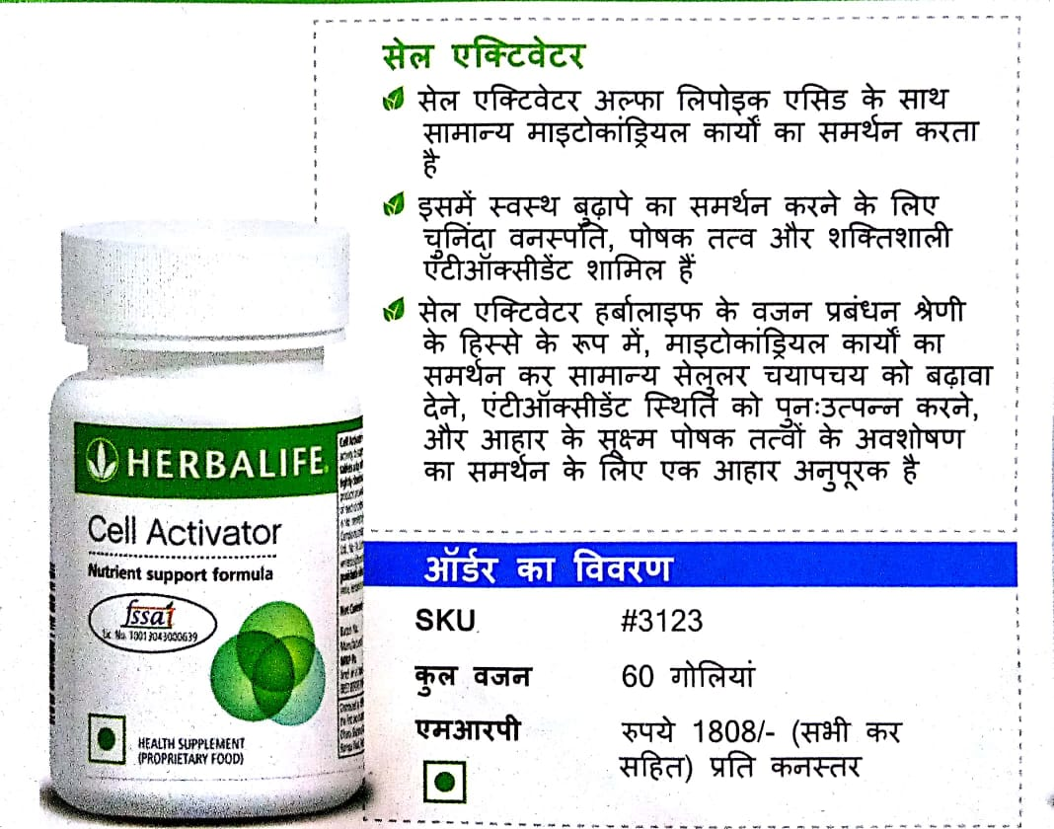
CELL ACTIVATOR

Slide 47



Slide 48


MULTIVITAMIN MINERALS
&HERBAL TABLETS

Slide 49


Slide 50
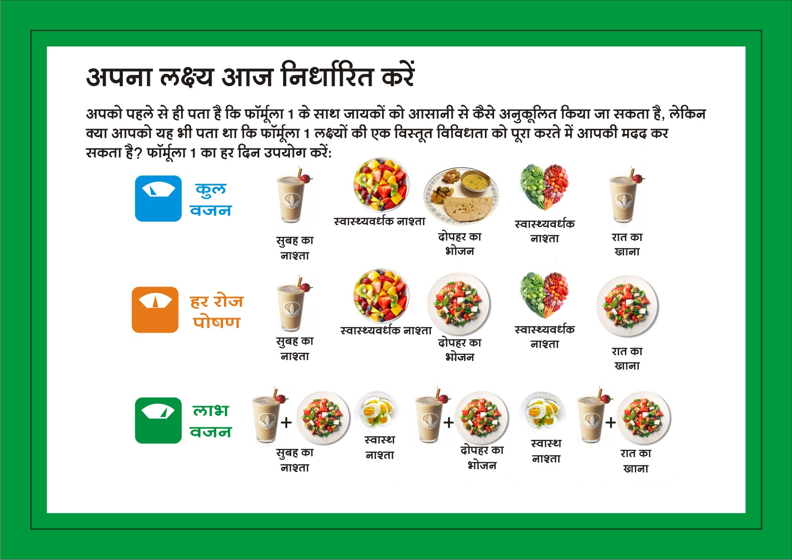
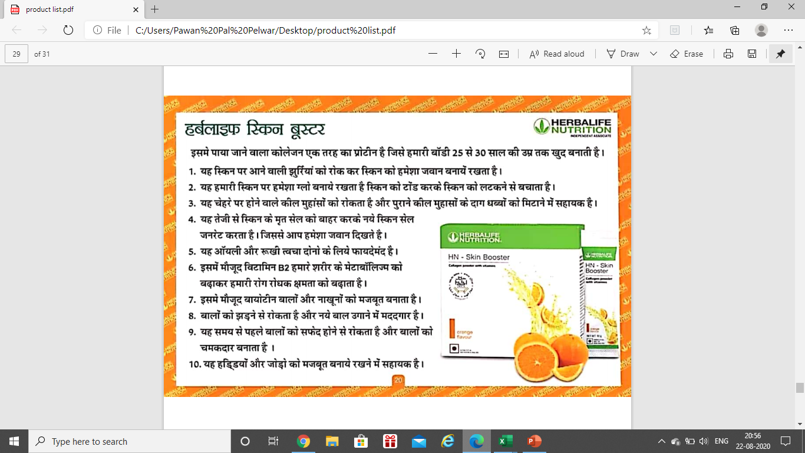
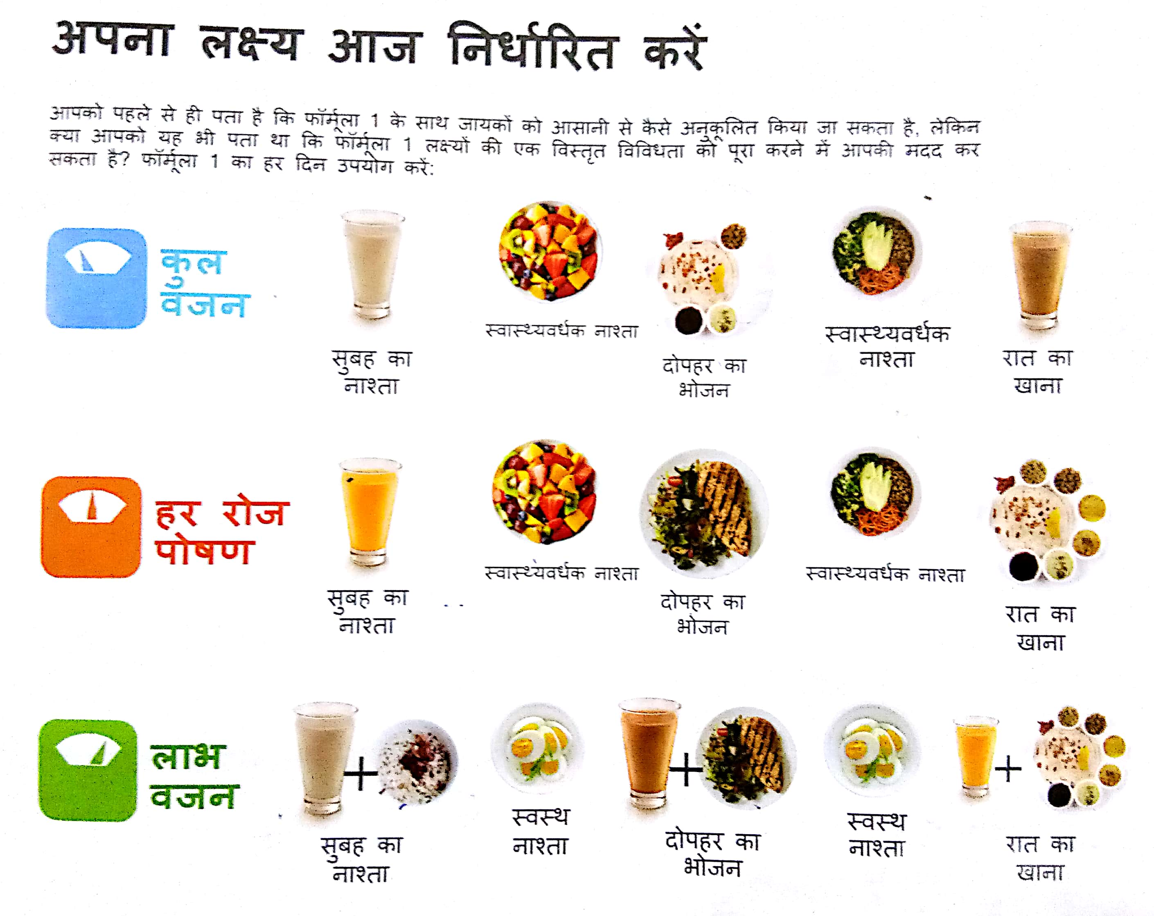

Slide 51
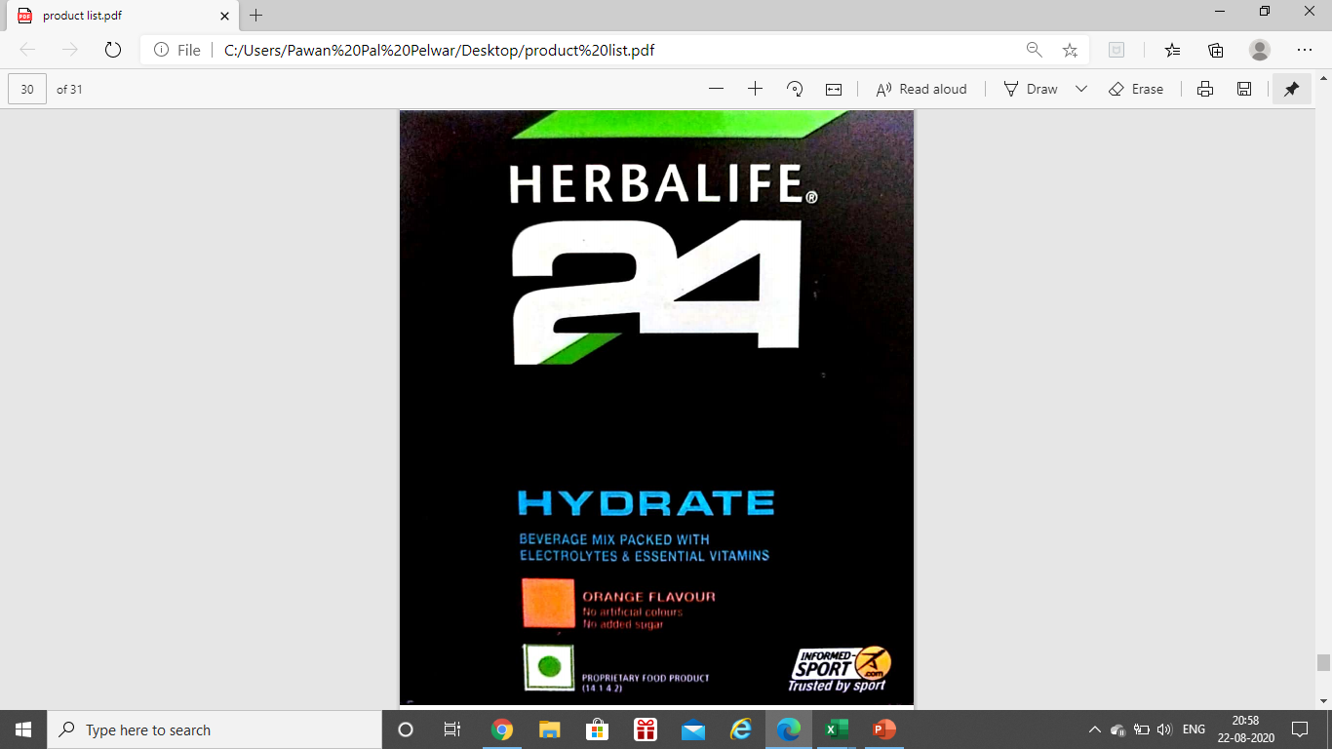

Slide 52



Slide 53
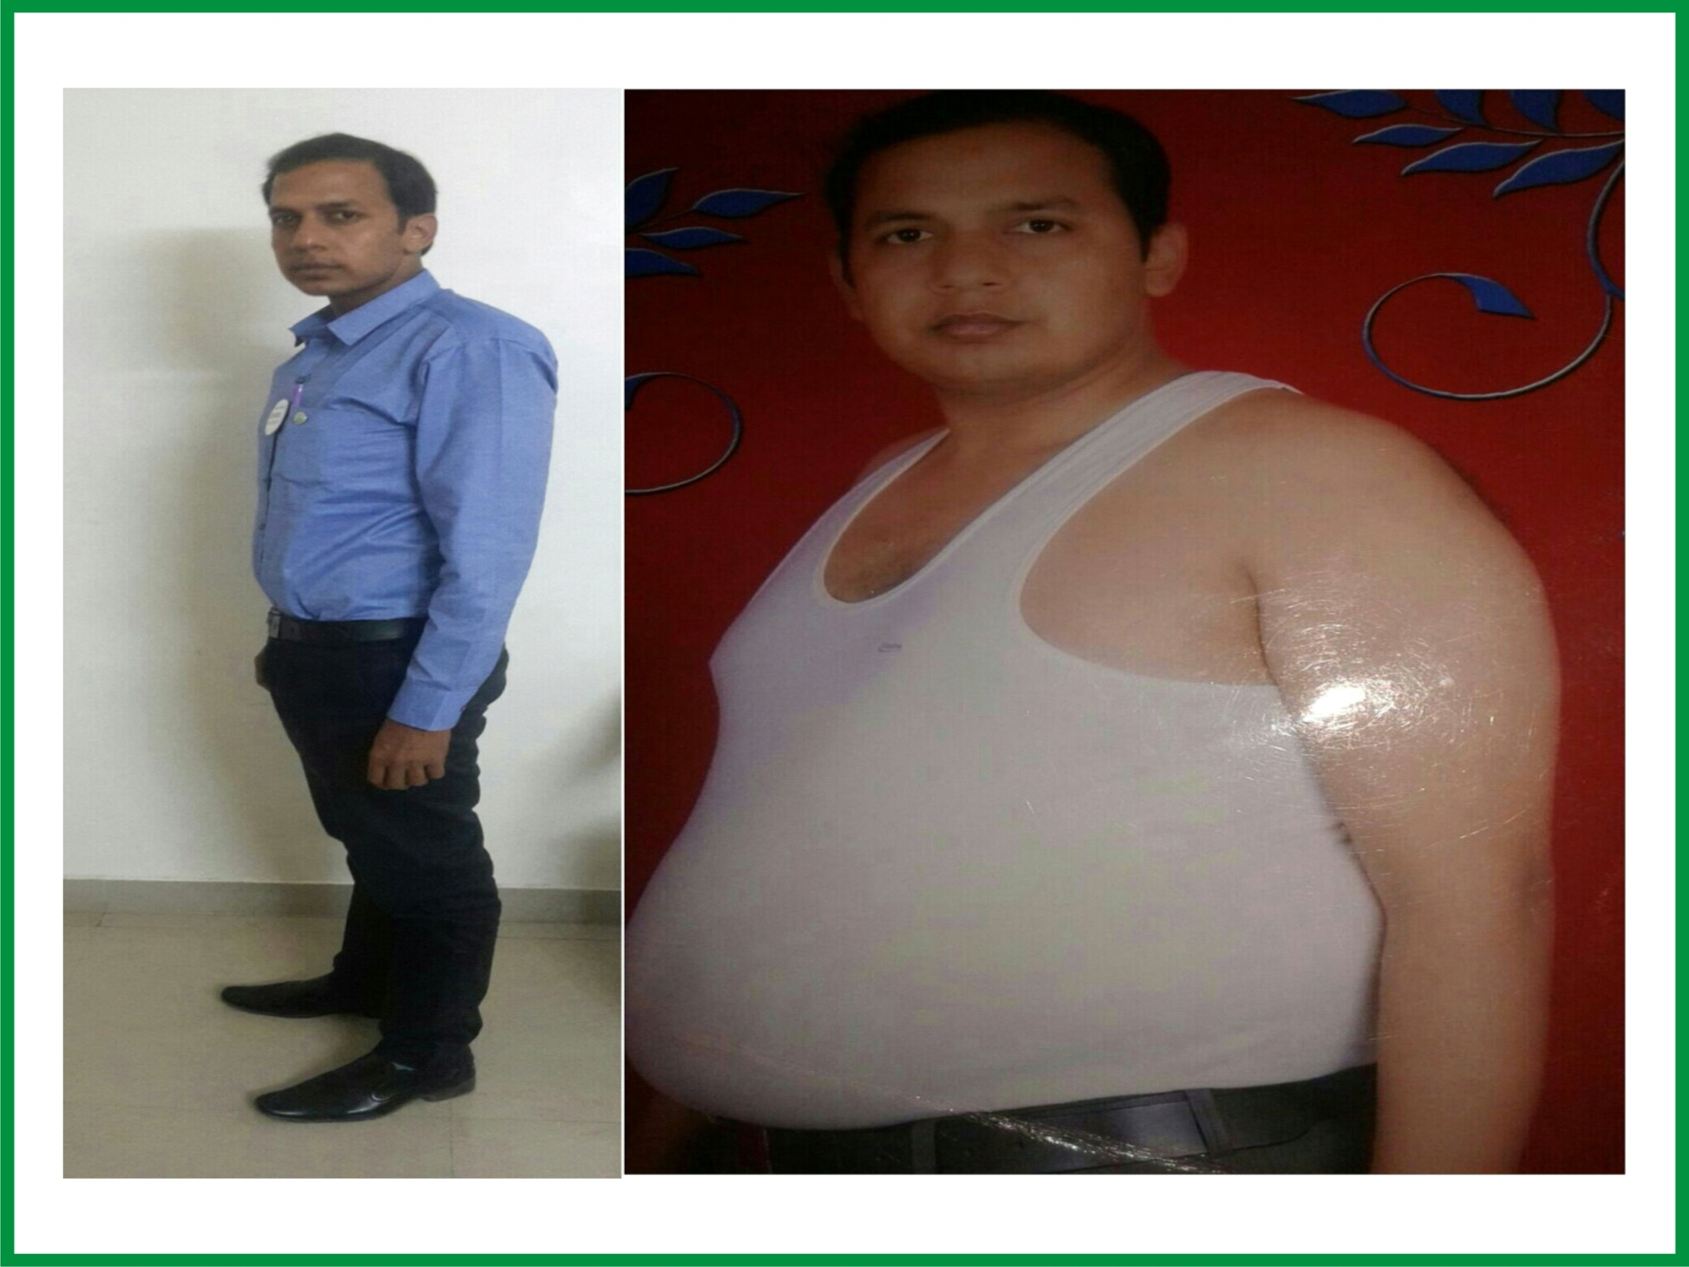


Slide 54


Slide 55


Slide 56


Slide 57


Slide 58



Slide 60
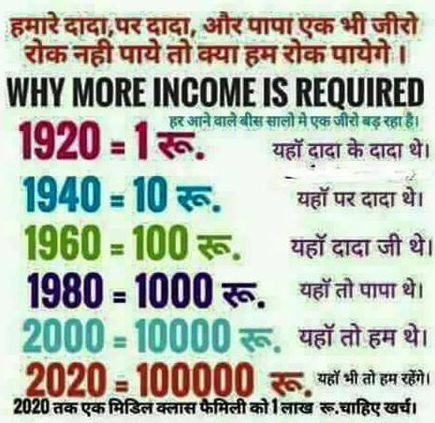

Slide 61


Slide 62
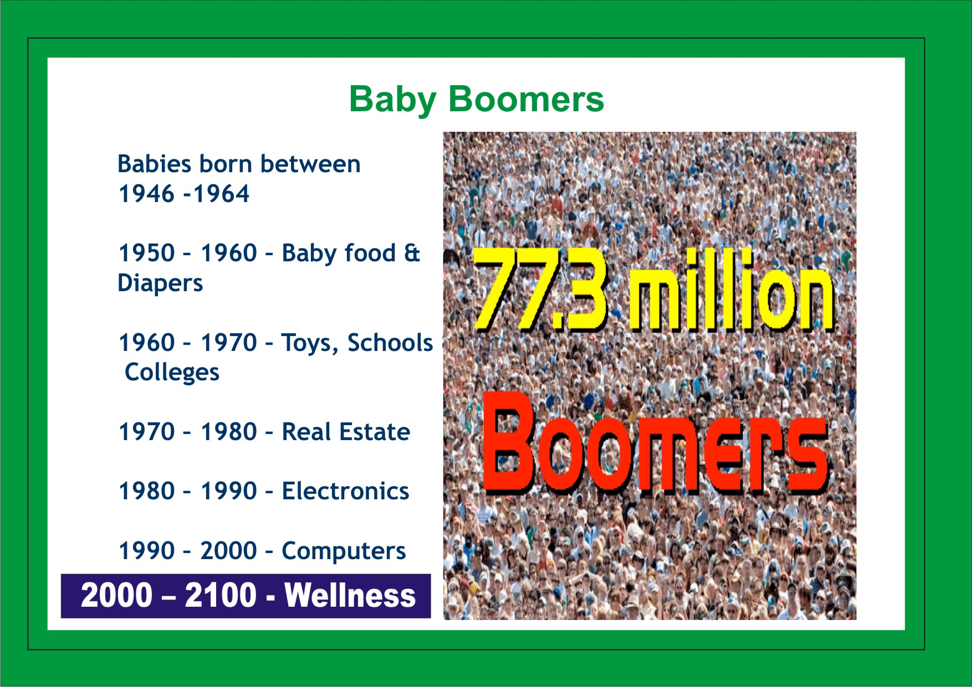
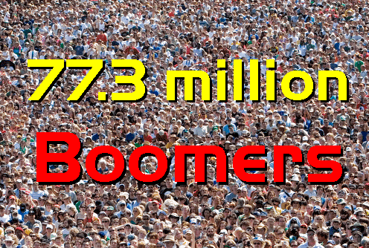
Baby Boomers
Babies born between 1946 -1964
1950 – 1960 – Baby food & Diapers
1960 – 1970 – Toys, Schools & Colleges
1970 – 1980 – Real Estate
1980 – 1990 – Electronics
1990 – 2000 – Computers
2000 – 2100 - Wellness

Slide 63


Slide 64


Slide 65
International Distributor
BUY minimum 5-7 customers product or 300 PPV
YOU GET 25% Discount
25%
Benefits:-
Only One Income i.e. Retail – 25%

Slide 66
Senior Consultant
BUY About 8-10 customers product or 500 PPV
YOU GET 35% Discount
35%
Benefits:-
Retail Profit Income – 35 %
Wholesale Profit – 10%

Slide 67
Success Builder
BUY About 12-15 customers product or 1000 PPV
YOU GET 42% Discount
42%
Benefits:-
Retail Profit Income – 42 %
Wholesale Profit – 7% to 17 %

Slide 68

FULLY QUALIFIED SUPERVISORS
Benefits :-
Permanent 50% Retail Profit
Wholesale Profits 8% to 25%
Royalty Checks
Leverage benefits
International training & Vacation
Small Work Big Income
Attend special workshops & trainings
50%
42%
35%
50 %
25%
Do 4000 VP in a months
Do 2000 VP X 2 months
Do 4000 VP Total in 3-12months
Do in a Team 5000VP

Slide 69
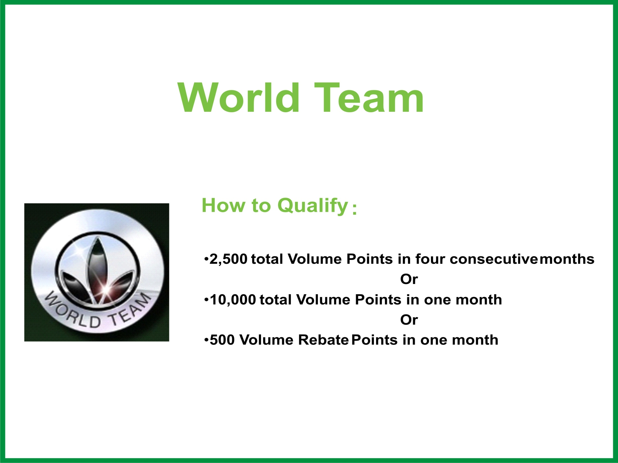
World Team Member

Slide 70
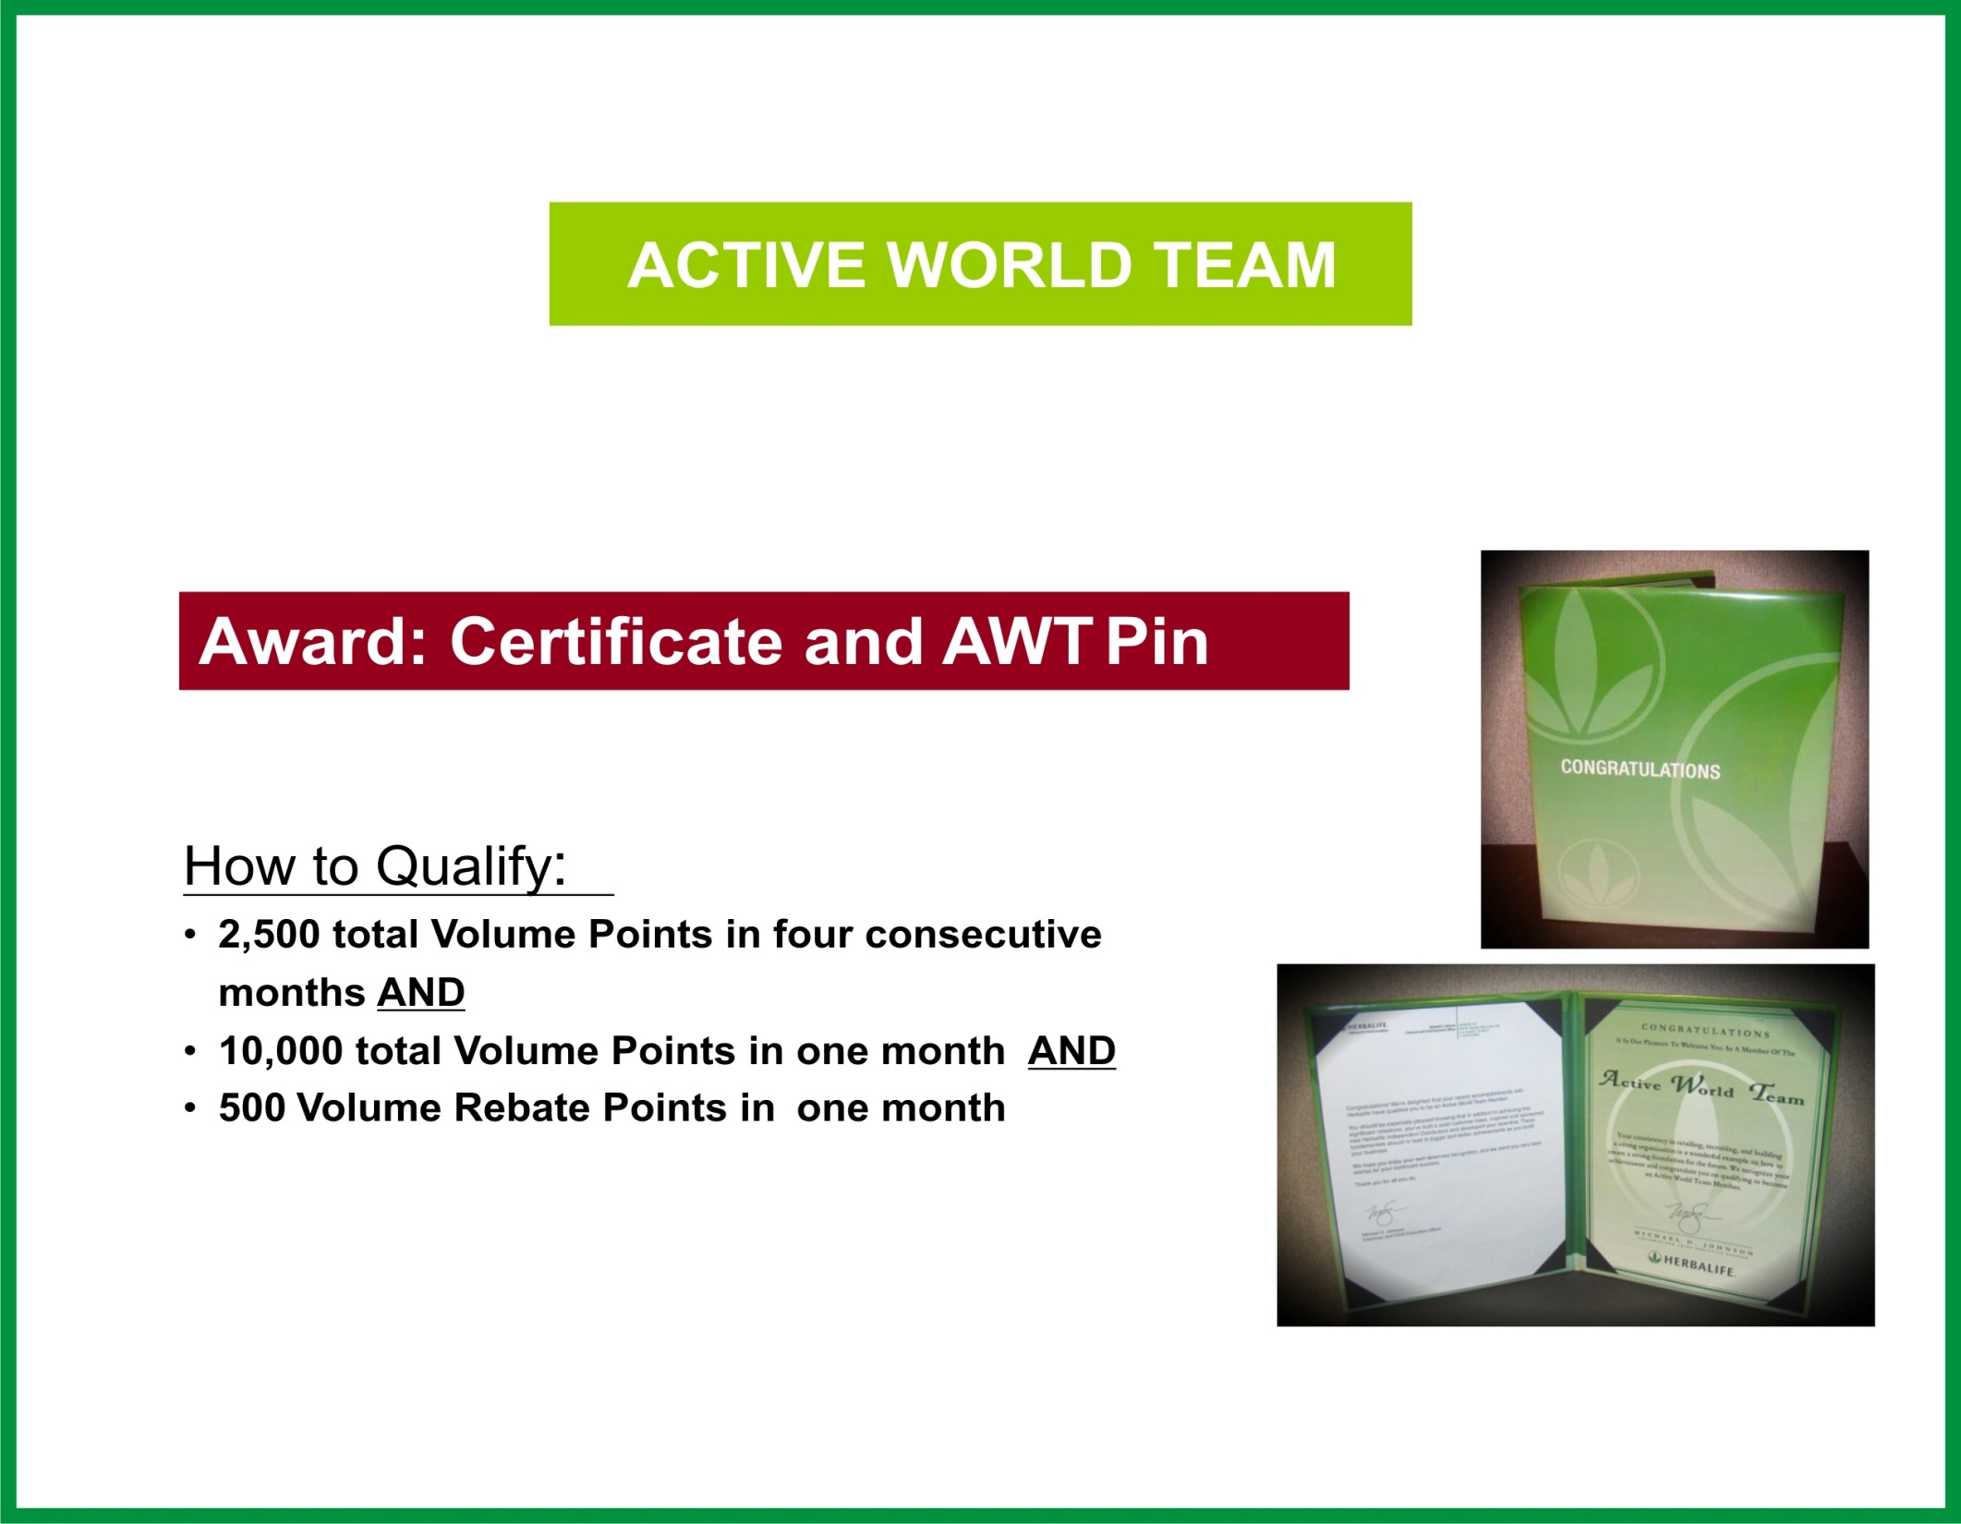
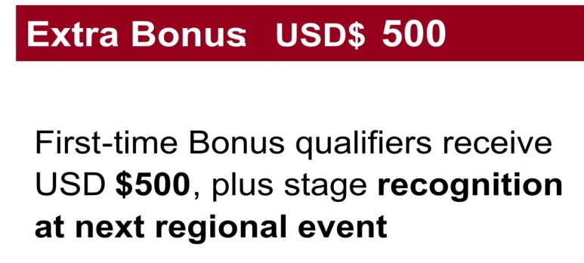
Active - World Team Member

Slide 71
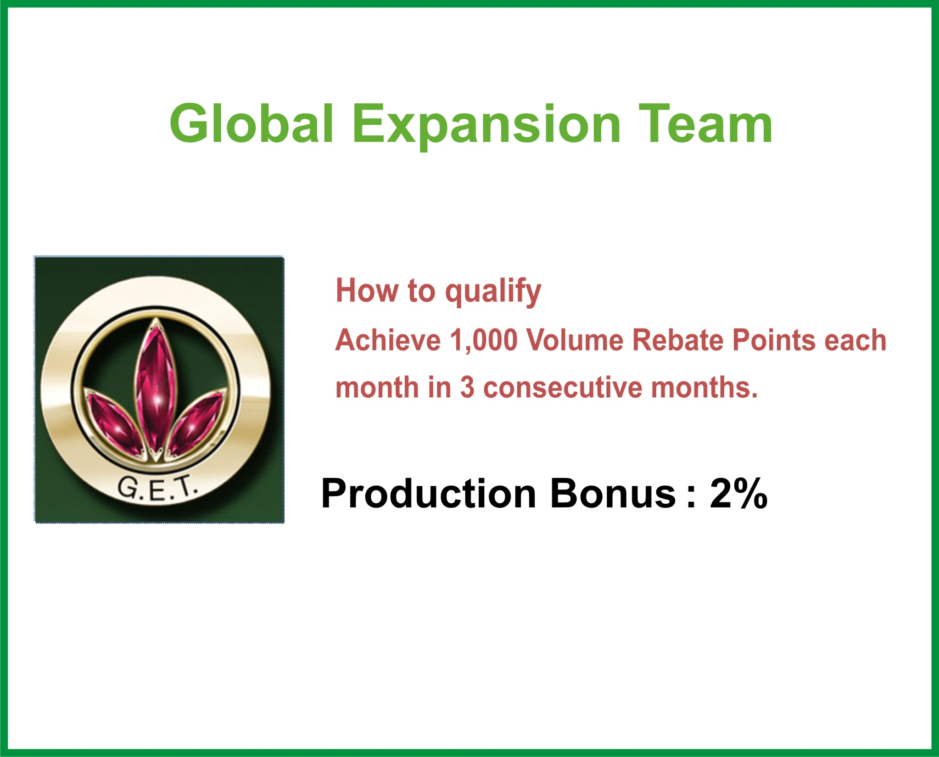
Global Expansion Team

Slide 72

Millionaire Team

Slide 73
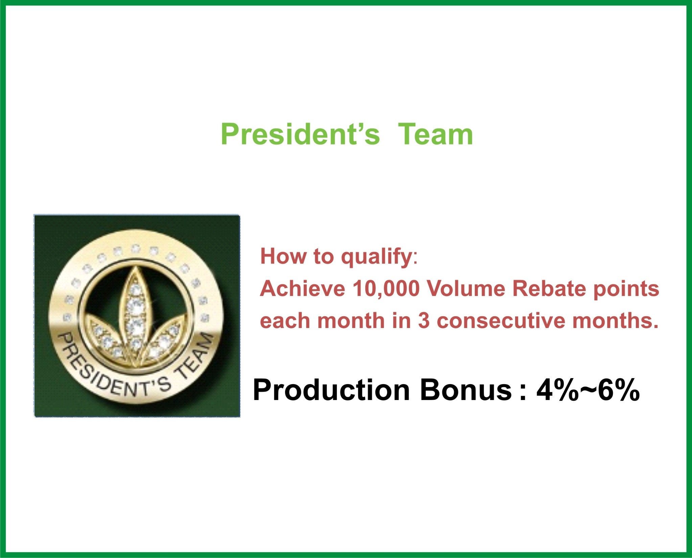
President’s Team Member

Slide 74


Slide 75


